Slide 1
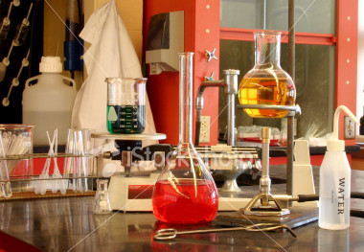
Lab Equipment
Chemistry
Plymouth North High School

Slide 2
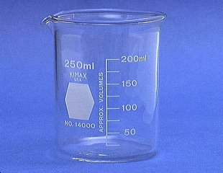
1. Beaker
Beakers hold solids or liquids that will not release gases when reacted or are unlikely to splatter if stirred or heated.

Slide 3
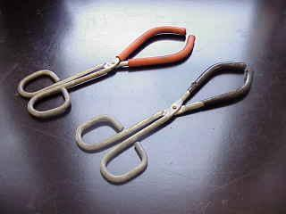
2. Beaker Tongs
Beaker tongs are used to move beakers containing hot liquids

Slide 4
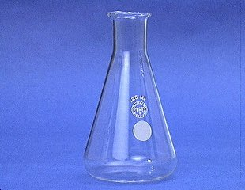
3. Erlenmeyer Flask
Erlenmeyer flasks hold solids or liquids that may release gases during a reaction or that are likely to splatter if stirred or heated.

Slide 5
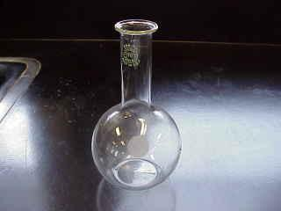
3. Florence Flask
Rarely used in first year chemistry, it is used for the mixing of chemicals. Narrow neck prevents splash exposure.

Slide 6
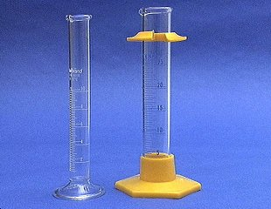
4. Graduated Cylinder
A graduated cylinder is used to measure volumes of liquids.

Slide 7
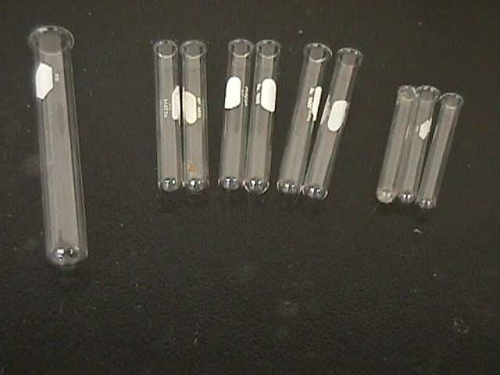
5. Test Tube – we commonly use 2 sizes:
Larger tube
sometimes used
Test tubes are used to mix chemicals, and also used to heat chemicals in.

Slide 8
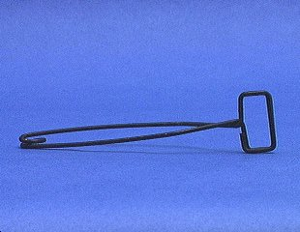
6. Test Tube Holder (clamp)
A test tube holder is useful for holding a test tube which is too hot to handle.

Slide 9
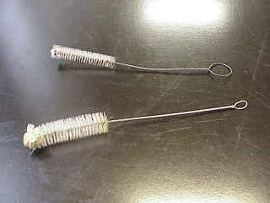
7. Test Tube Brushes
Test tube brushes are used to clean test tubes and graduated cylinders.
Forcing a large brush into a small test tube will often break the tube.

Slide 10
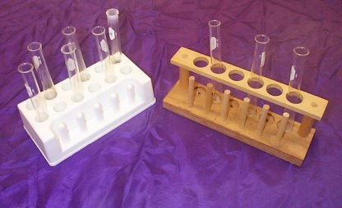
8. Test Tube Rack
Test tubes can be placed upside down on these pegs for drying.
Test tube racks are for holding, drying, and organizing test tubes in a vertical position

Slide 11
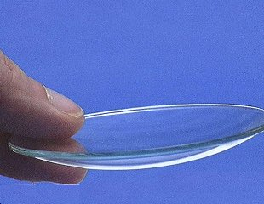
9. Watch Glass
A watch glass is used to hold a small amount of solid, such as the product of a reaction.
Can also be used as a cover for an evaporating dish or beaker.
Since they may not be made of heat-resistant glass, they are usually not heated – they break!

Slide 12
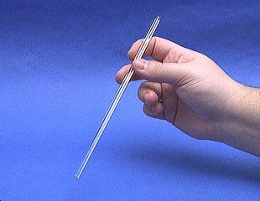
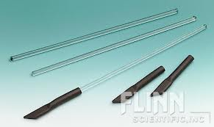
10. Glass Stirring Rod
A glass rod is used to manually stir solutions. It can also be used to transfer a single drop of a solution.
A rubber scrapper (policeman) may be attached.

Slide 13
11.Spot Plate
Spot plates are used when we want to perform many “small-scale” reactions at one time.
We will use these sometimes during the year, and is like having lots of test tubes available at one time!
Numerous “well” depressions

Slide 14
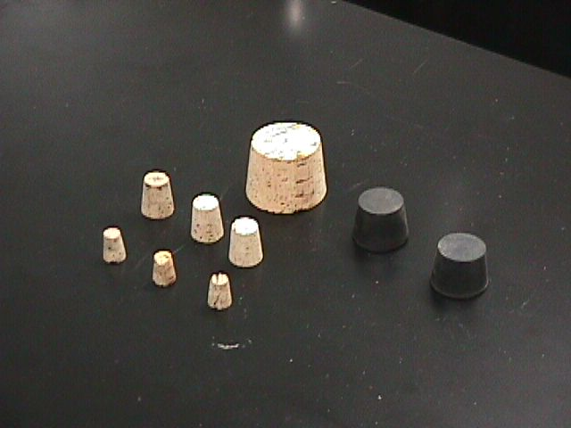
12. Rubber Stoppers & Corks
Rubber and cork stoppers are used to close test tubes and flasks, thus avoiding spillage or contamination.
Containers should NEVER be heated when there is a stopper in place – pressure will build up, and an explosion could occur.

Slide 15
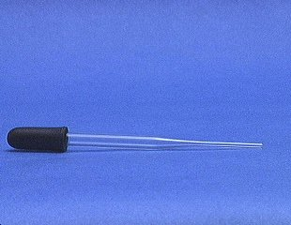
13. Medicine Dropper
A medicine dropper is used to transfer a small volume of liquid (less than one mL).
On top of each medicine dropper is a “rubber bulb”

Slide 16
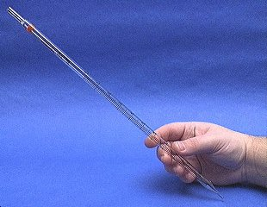
14. Graduated Pipet
A graduated pipet measures and delivers exact volumes of liquids.
These will also use a rubber bulb for suction.
Graduations in mL

Slide 17
15. Buret
A buret is used to deliver solution in precisely-measured, variable volumes.
Burets are used primarily for titration, to deliver one reactant until the precise end point of the reaction is reached.

Slide 18
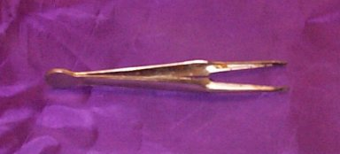
16. Forceps
Forceps are used to hold or pick up small objects – Remember: it is best to never touch chemicals with your hands.

Slide 19
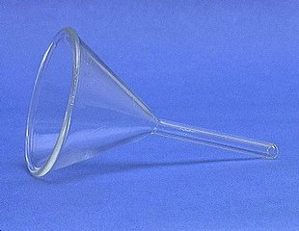
17. Funnel
A funnel is used to:
1) aid in the transfer of liquids from one vessel to another, and 2) hold filter paper while filtering.
(Some pieces of equipment are plastic, others are glass.)

Slide 20
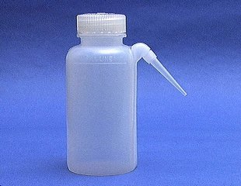
18. Wash Bottle
A wash bottle has a spout that delivers a wash solution to a specific area. Distilled water is the only liquid that should be used in a wash bottle.

Slide 21
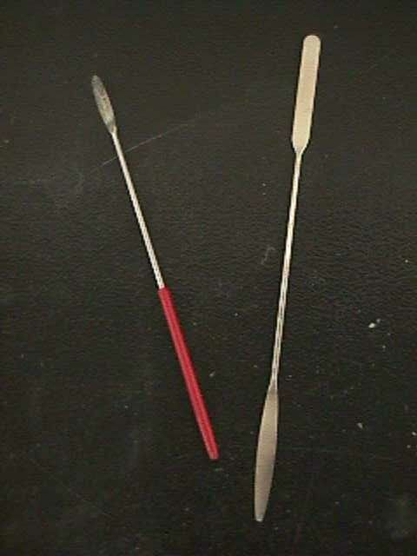
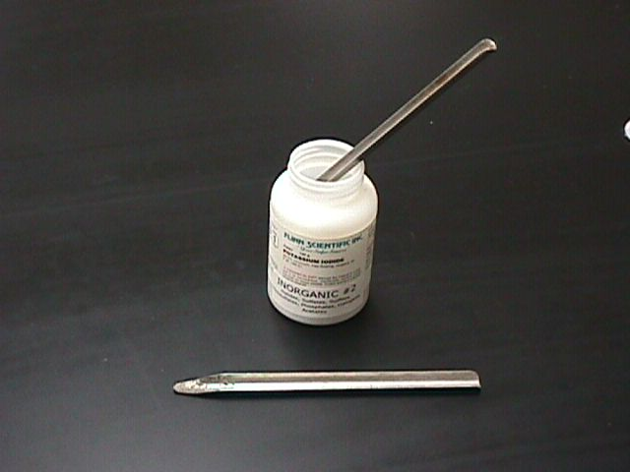
19. Scoopula (spatula)
Scoopulas are used to dispense solid chemicals from their containers.
Spatulas are sometimes also used.
The chemicals should never be transferred with your bare hands. (assume they are all dangerous)

Slide 22
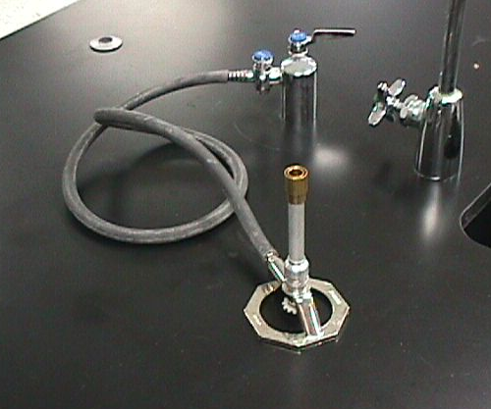
20.Burner
Burners are used for the heating of nonflammable liquids and solids.
We have Tirrell burners to use in our classroom.
Hot plates will be used to gently heat any flammable chemicals.
In order to get the best flame, you might need to make adjustments each time you use the burner – practice this!

Slide 23
How to Light the Lab Burner
1. Examine the hose for any damage.
2. Perform initial adjustments.
3. Attach rubber hose to outlet.
4. Light the match.
5. Turn ON gas outlet.
6. Carefully bring the match to the top of the burner.
7. Perform any required final adjustments.

Slide 24
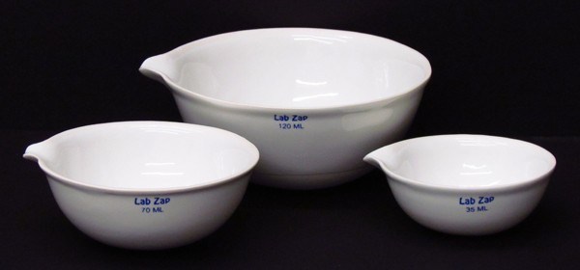
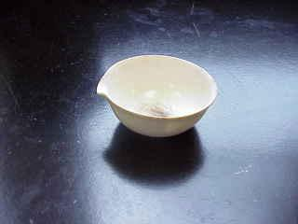
21. Evaporating Dish
The evaporating dish is used for the heating of stable solid compounds and elements and for sepating mixtures of liquids and solids.

Slide 25
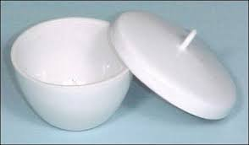
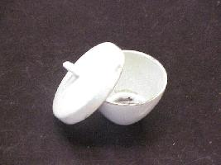
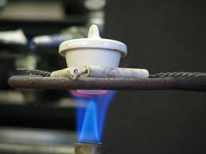
22. Crucible & Cover
Crucibles are used for heating certain solids, particularly metals, to very high temperatures.

Slide 26
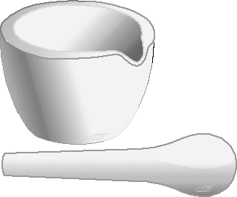
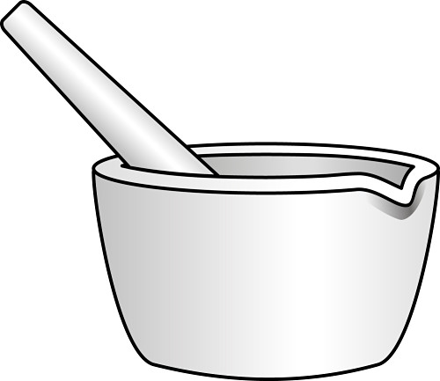
23. Mortar and Pestle
These are used to crush solid chemicals into a fine powder. A twisting motion is used to gently crush the solid.

Slide 27
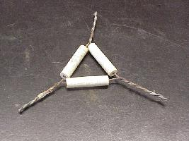
24. Pipestem (Clay) Triangle
The clay triangle is used as a support for porcelein crucibles when being heated over a Bunsen burner.

Slide 29
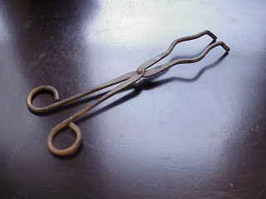
25. Crucible Tongs
For handling hot crucibles; also used to pick up other hot objects. NOT to be used for picking up beakers!

Slide 30
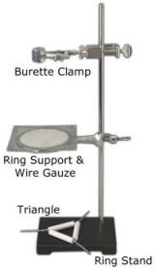
26. Ring stand (and their Components)
Ring stands are a safe and convenient way to support equipment holding reactions that require heating using a lab burner.
The base can also be used as an insulating pad to place hot objects on while they cool.

Slide 31
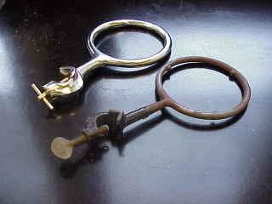
Ringstands and their Components 27. Iron Rings
Iron rings connect to a ringstand and provide a stable, elevated platform for the reaction.

Slide 32
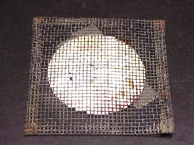
Ringstands and their Components 28. Wire Gauze
Wire gauze sits on the iron ring to provide a place to stand a beaker.
On older wire gauze, the white material is asbestos!

Slide 33
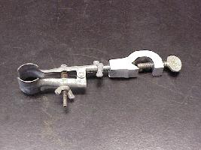
Ringstands and their Components 29. Utility Clamps
Utility clamps are used to secure test tubes, distillation columns, and burets to the ringstand.

Slide 34
30. Triangular File
Triangular files are used primarily to cut glass tubing, a skill that your instructor will share with you later.

Slide 35
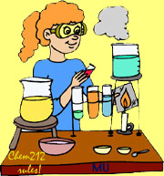
** On lab experiment days **
Bring REAL SHOES, REAL BRAINS, and your LABORATORY MATERIALS. You must have completed your pre-lab assignment and have it in your possession to begin class. Your calculator, textbook, and class notes are also suggested.

Slide 36
“Be Alert and
Proceed with Caution”

