Slide 1
ACTIVITY 1-2 YOU’RE AN EYEWITNESS! Directions: You will be given three minutes to study the picture distributed by your teacher. Then you will be asked to test your powers of observation by answering the questions provided.

Slide 2
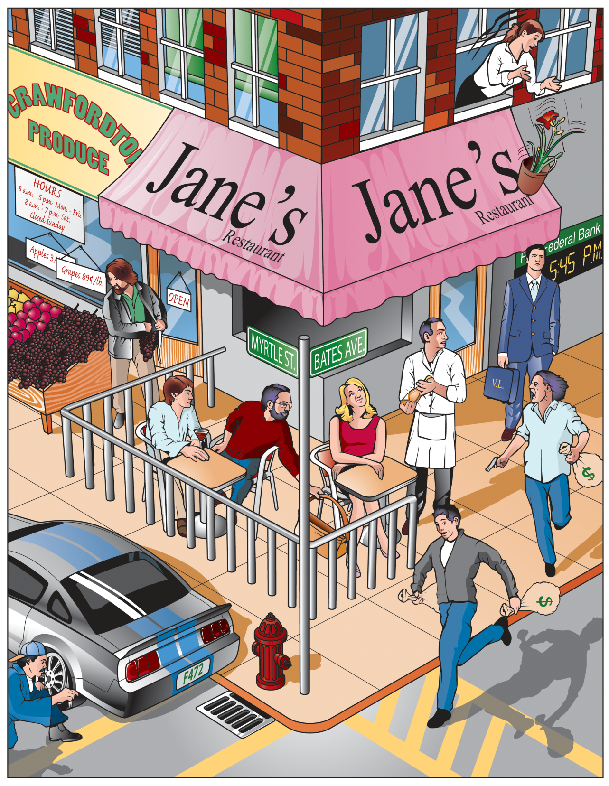

Slide 3
1. What time was it by the bank’s clock? _______________
2. What day of the week was it? ________________
3. What was the name of the outdoor cafe? ___________________
4. On what street was the entrance to the restaurant? _._
5. How many thieves are staging the holdup? ________________
6 Were they armed? ___________________
7. How many bags of loot were they carrying? _________________
8. Was the thief in the street wearing a hat? _________
9. How many people, besides you and the holdup men, were at the scene of the
robbery?________
10. What were the initials of the man in the business suit? ____________
11. What immediate danger was he in? _______
12. Was the onlooker from the second floor a man or a woman? ____
13. What store was next to the cafe? _____ _______
14. What was the shopper stealing? _____________________
15. What was the license number of the car parked in front of the store? __
16. How do you know the car was illegally parked? ______
17. What part of the car was being vandalized? ____________________
18. What type of hat is the person wearing who is vandalizing the car? __
19. What offense was in progress against the lady diner? __
20. What was the cost of the grapes _______.__

Slide 4
1. What time was it by the bank’s clock? _____5:45 PM__________
2. What day of the week was it? ______Saturday__________
3. What was the name of the outdoor cafe? ________Jane's___________
4. On what street was the entrance to the restaurant? _Bates Ave & Myrtle St._
5. How many thieves are staging the holdup? _________two_______
6 Were they armed? __________yes_________
7. How many bags of loot were they carrying? _____3____________
8. Was the thief in the street wearing a hat? _____no____
9. How many people, besides you and the holdup men, were at the scene of the
robbery?_____8___
10. What were the initials of the man in the business suit? ____VL________
11. What immediate danger was he in? ___flower pot falling on his head____
12. Was the onlooker from the second floor a man or a woman? _woman___
13. What store was next to the cafe? _____ Crawfordtown Produce_______
14. What was the shopper stealing? ____________grapes__________
15. What was the license number of the car parked in front of the store? F472__
16. How do you know the car was illegally parked? __It was between 4-6 PM____
17. What part of the car was being vandalized? __________tire__________
18. What type of hat is the person wearing who is vandalizing the car? _baseball_
19. What offense was in progress against the lady diner? __purse snatching
20. What was the cost of the grapes _______$.89/lb.__

Slide 5
Count the number of questions that you had correct and figure out your percent correct.
Example: If you had 9 correct, you were correct only 45% of the time.

