Slide 1
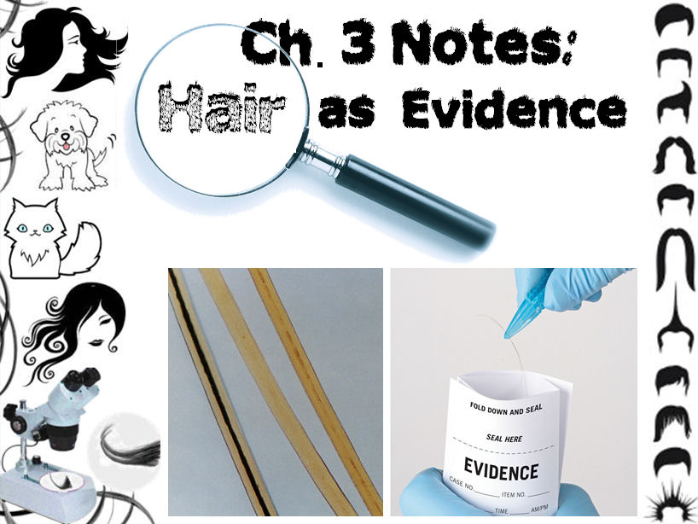

Slide 2

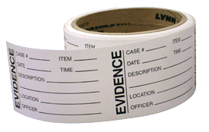
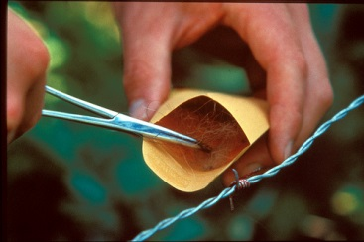
Hair as Evidence
Human hair is one of the most frequently found pieces of evidence at the scene of a violent crime. Unfortunately, hair is not the best type of physical evidence for establishing identity. It is not possible to show with any certainty that two hairs came from the same person or animal. However, hair can be used to rule out certain suspects or scenarios. It can also be used to corroborate (support) other physical evidence if it is consistent with the rest of the evidence.

Slide 3
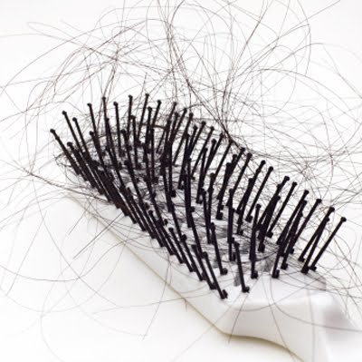
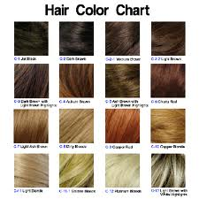
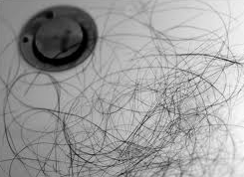
The average human has approximately 250,000 hairs that get replaced in a 3 year cycle.
    About 250 hairs are shed daily; about 100
    being from the head.
    Blondes tend to have more head hairs than brunettes. Red heads have the least.

Slide 4
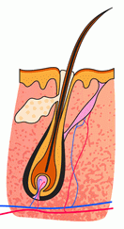
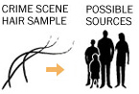
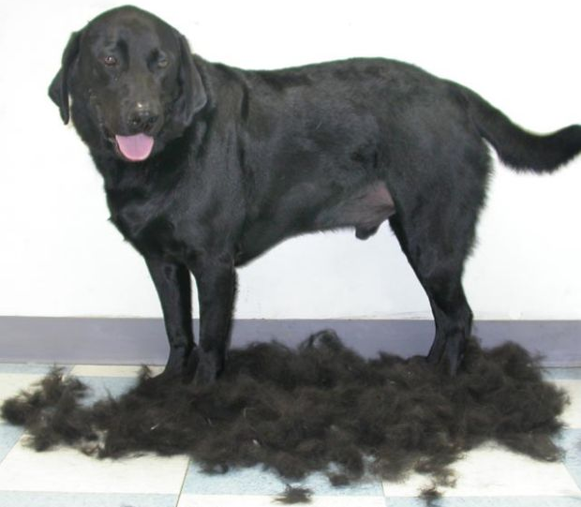
Hair at a Crime Scene
Hair is considered class evidence. Alone (without follicle cells attached), it cannot be used to identify a specific individual.
Hair can easily be left behind at a crime scene. It can also adhere to clothes, carpets, and many other surfaces and be transferred to other locations. This is called secondary transfer. Secondary transfer is particularly common with animal hair.

Slide 5

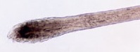
Hair analysis may be helpful to determine the following:
Human or animal origin
The broad racial background of an individual
Body region from which the hair came
Manner in which the hair was removed
Chemical tests can provide a history of the use of drugs and other toxins, indicate the presence of heavy metals, and provide an assessment of nutritional deficiencies.
When the follicle of a hair is present, DNA evidence may be obtained and it can lead to individual identification.
All of these make hair helpful
evidence for crime scene analysis.

Slide 6
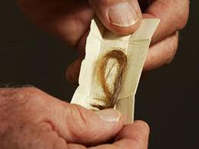
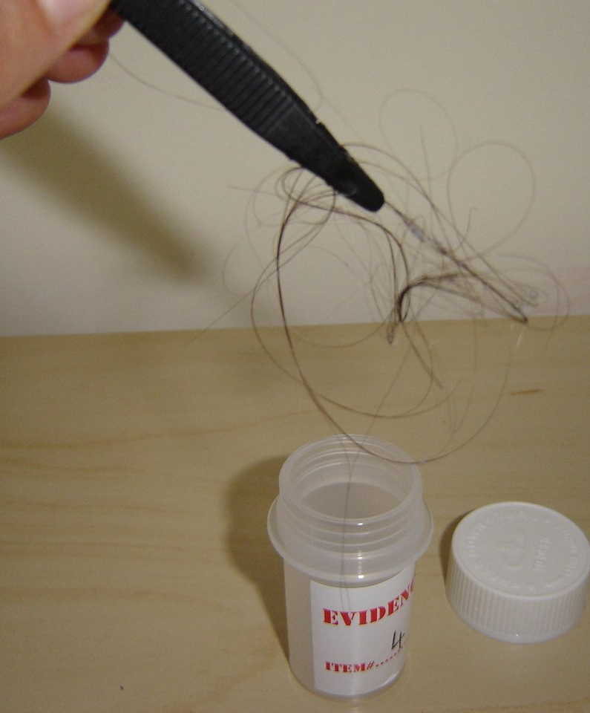
Collecting Hair as Evidence
Recover all hair present.
Use the fingers or tweezers to pick up visible strands of hair when possible. Tape lift may be used to help collect hairs if needed. When surfaces are large, they can also be vacuumed.
Place hair in paper bindles or coin envelopes which should then be folded and sealed in larger envelopes. Label the outer sealed envelope.

Slide 7
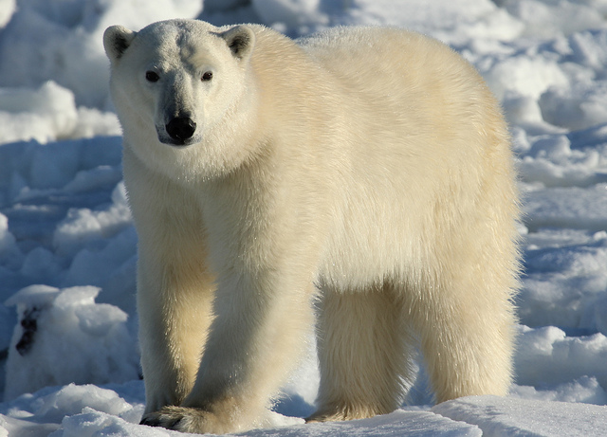
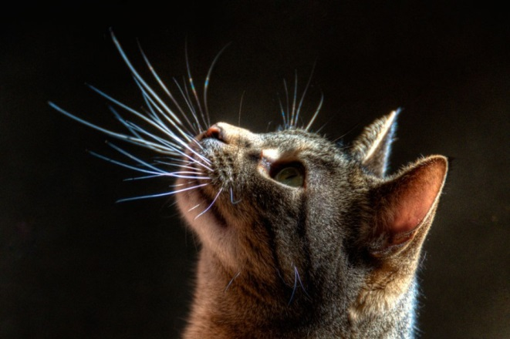
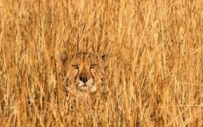
Function of Hair
All mammals have hair. Its main purpose is to regulate body temperature— to keep the body warm by insulating it.
Other functions of hair:
decrease friction
to protect against sunlight
sensory
camouflage

Slide 8
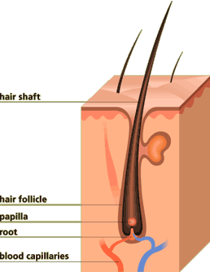
Structure of Hair
A hair consists of two parts: a follicle and a shaft.
Follicle is a club-shaped structure in the skin
  Hair is produced from the follicle. Humans develop hair follicles during fetal development, and no new follicles are produced after birth.
At the end of the follicle is the papilla, a network of blood vessels that supply nutrients to feed the hair and help it grow.
The bulb also contains a sebaceous gland to secrete oil, erector muscles that cause hair to stand upright, and nerve cells to respond to the environment.

Slide 9
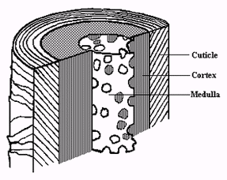
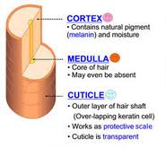
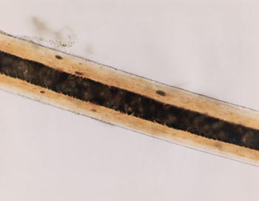
The hair shaft is composed of the protein keratin, which is produced in the skin. Keratin makes hair both strong and flexible.
The hair shaft is made up of three layers:

Slide 10
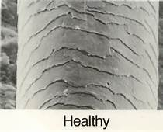
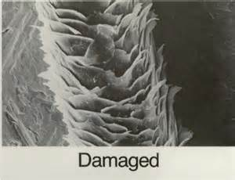
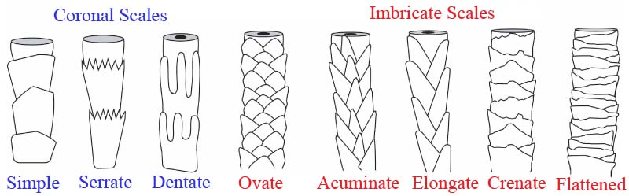
Cuticle
Transparent outer layer of the hair; protects the hair.
Made of scales that overlap one another and point toward the tip end
Different types of mammals have different cuticle scale patterns.

Slide 11
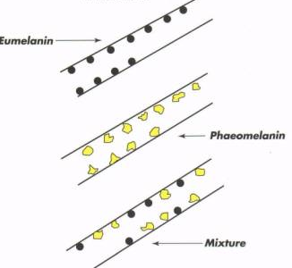
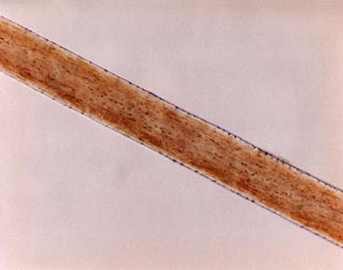
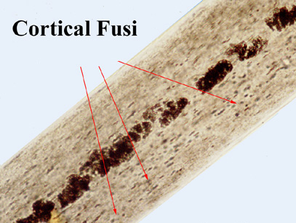
Cortex
Middle layer; largest part of the hair shaft, contains pigment granules
There are two main pigments found in human hair:
  Eumelanin- gives color to brown or black hair
  Pheomelanin- produces the color in blonde or red hair
Notes:
Hair color is determined by:
1. The type of natural color pigment melanin present in your hair's cortex.
Eumelanin (black pigment)
Phenomelanin (red/yellow pigment)
2. How many melanin granules exist
3. Whether those granules are close together or far apart

Slide 12
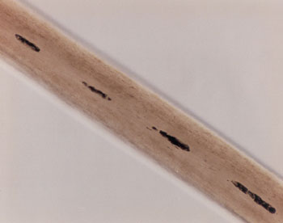
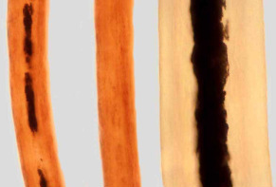
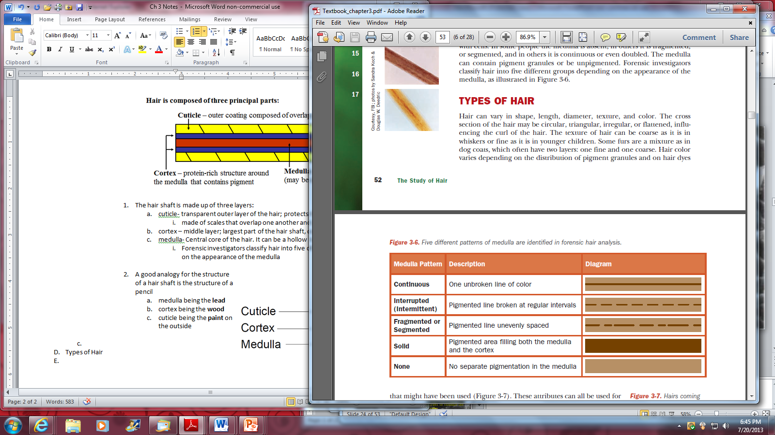
Medulla
Central core of the hair. It can be a hollow tube, or filled with cells.
Forensic investigators classify hair into five different groups depending on the appearance of the medulla.

Slide 13
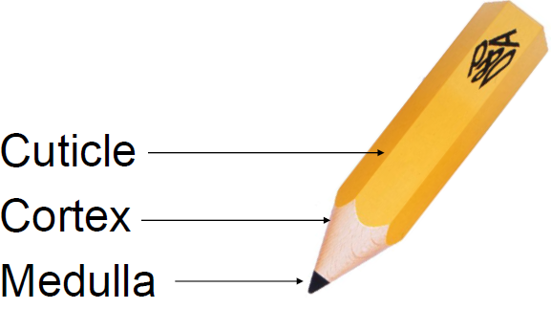
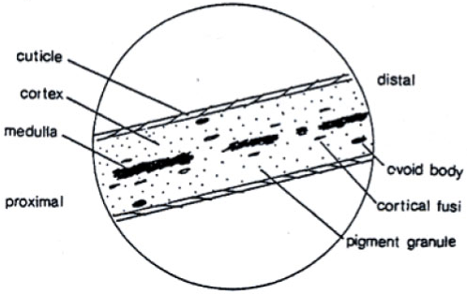
Analogy for the structure of the hair shaft:
Good example
of a microscope
drawing of hair:

Slide 14
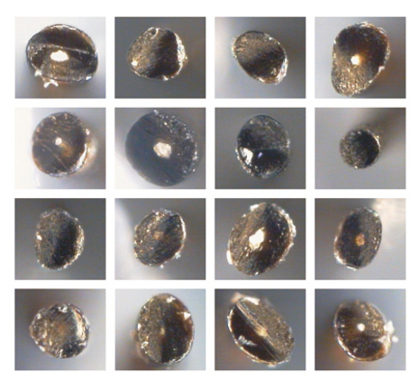
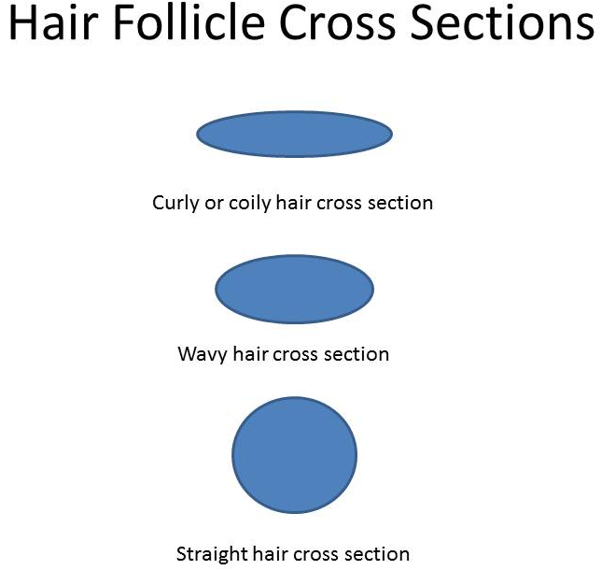
Differences in Hair
Hair can vary in shape, length, diameter, texture, and color.
The cross section of the hair may be circular, triangular, irregular, or flattened, influencing the curl of the hair.
The texture of hair can be coarse as it is in whiskers or fine as it is in younger children.

Slide 15
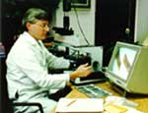

Differences in hair can be used for identification (association) or exclusion in forensic investigations.
Notes:
http://www.fbi.gov/about-us/lab/forensic-science-communications/fsc/july2000/deedric1.htm

Slide 16
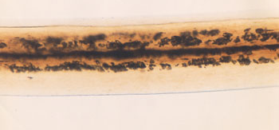
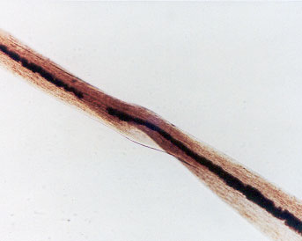
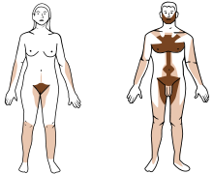
Hair from Different Parts of the Body
Six types of hair on the human body:
  Head hair
  Eyebrows and eyelashes
  Beard and mustache hair
  Underarm hair
  Auxiliary or body hair
  Pubic hair
Facial Hair
Pubic Hair
Each hair type has its own shape and characteristics.
Hair from head and pubic region are the most common hairs found at crime scenes

Slide 17
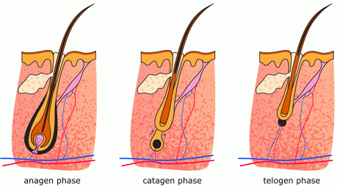
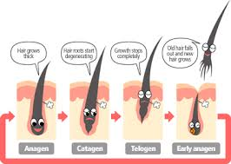
The Life Cycle of Hair
A= Period of active
growth
C= Transitional or
regressive stage
T= Final resting stage

Slide 18
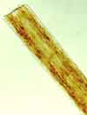

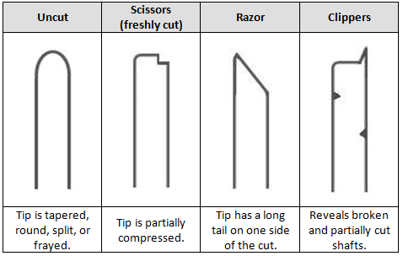
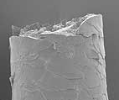
Distal Tips
The appearance of the tip of the hair shaft is an important comparative characteristic.
    If sufficient sample is available, it may be possible to identify the type of treatment and estimate the length of time since the last cutting.
Tips usually take on a rounded form in 2-3 weeks.

Slide 19
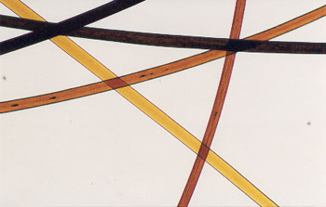
Treated Hair
When a person chemically treats his or her hair, traces of the chemicals used remain. Some of these changes are subtle and can be detected only by using a microscope.
Bleaching hair removes pigment granules and gives hair a yellowish tint. It also makes hair brittle and can disturb the scales on the cuticle.
Dyeing hair changes the color of the hair shaft. An experienced forensic examiner can immediately recognize the color as unnatural. In addition, the cuticle and cortex both take on the color of the dye.

Slide 20
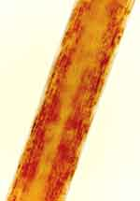
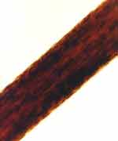
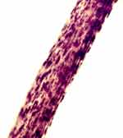
Racial Differences
A human hair can be associated with a particular racial group based on established models for each group. Forensic examiners differentiate between hairs of Caucasoid (European ancestry), Mongoloid (Asian ancestry), and Negroid (African ancestry) origin, all of which exhibit microscopic characteristics that distinguish one racial group from another. Head hairs are generally considered best for determining race, although hairs from other body areas can be useful.
Caucasian or European hair
Negroid or African hair
Mongoloid or Asian hair

Slide 21
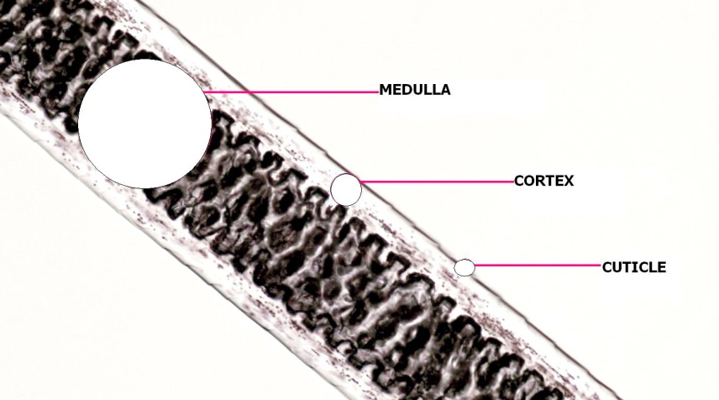
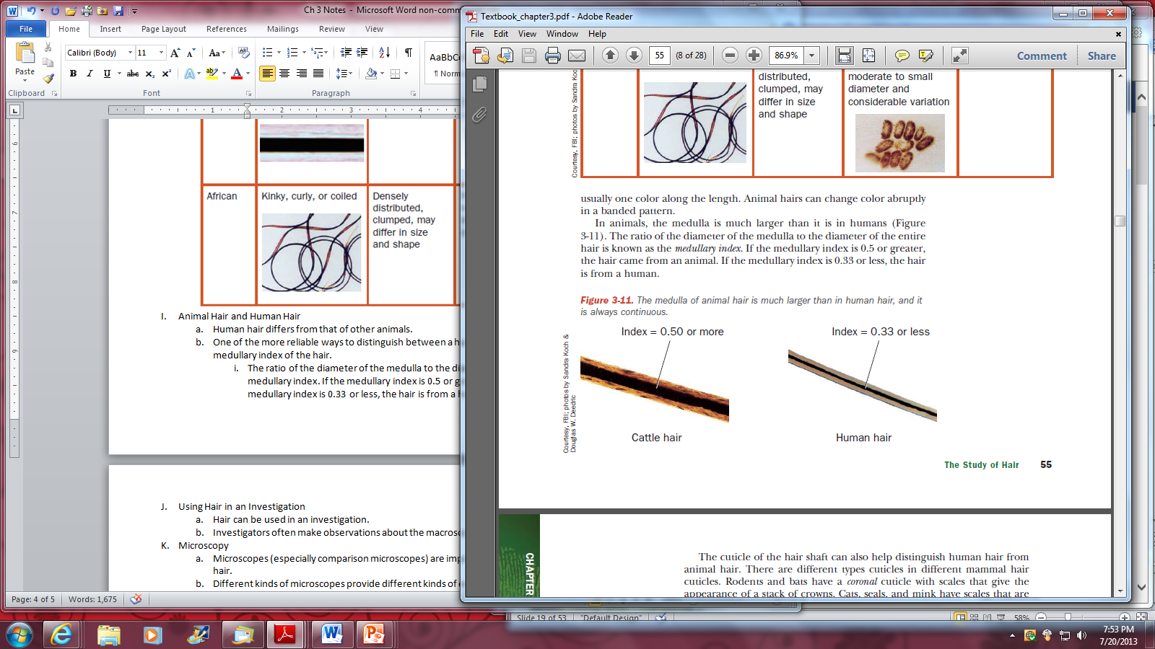
Animal Hair and Human Hair
One of the more reliable ways to distinguish between a human and other animal hair is to calculate the medullary index of the hair.
Diameter of the medulla divided by the diameter of the entire hair is known as the medullary index.
If the medullary index is 0.5 or greater, the hair came from an animal.
If the medullary index is 0.33 or less, the hair is from a human.

Slide 22
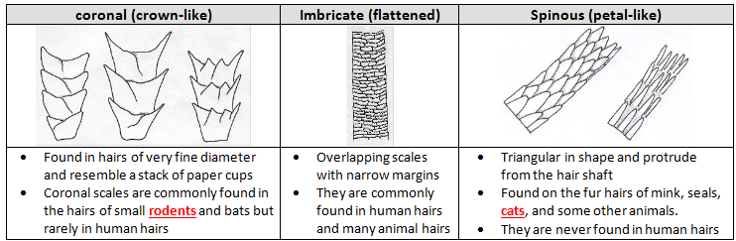
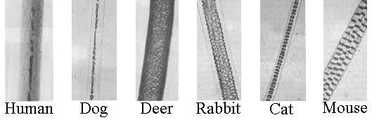
Cuticle scales differ between species of animals;
three basic scale structures include:
Animal hairs also show a wide variety of medulla patterns:

Slide 23
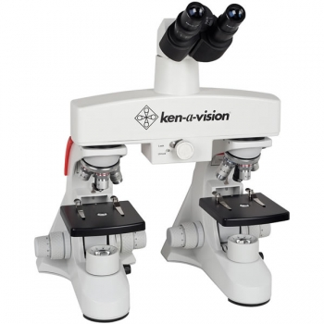

Hair viewed for forensic investigations is studied both macroscopically and microscopically
Different kinds of microscopes provide different kinds of evidence.
Comparison microscopes are especially important tools to the forensic investigation of hair.
A fluorescence microscope is equipped with filters to detect fluoresced light, indicating the presence of a dye or other treatment.

Slide 24



Electron microscopes provide incredible detail of the surface or interior of the sample, magnifying the object 50,000 times or more.

Slide 25

Testing for Substances in the Hair Shaft
Because hair grows out of the skin, chemicals that the skin absorbs and some toxins and drugs which an individual ingests can leave traces in the hair.
In order to test hair, it must first be dissolved in an organic solvent that breaks down the keratin and releases any substances that have been incorporated into the hair.
A forensic chemist can then perform chemical tests for the presence of various substances to provide evidence of poisoning or drug use.

Slide 26



Neutron Activation Analysis (NAA)
A useful technique that can identify up to 14 different elements in a single two-centimeter-long strand of human hair.
The probability of the hairs of two individuals having the same concentration of these different elements is about one in a million.
Notes:
http://forensic-science-fall-2010.wikispaces.com/Neutron+Activation+Analysis

Slide 27




Testing the Hair Follicle
If hair is forcibly removed from a victim or suspect, the entire hair follicle (called a follicular tag) may be present. If so, blood and tissue attached to the follicle may be analyzed for blood type and DNA.
Naturally shed hairs, such as a head hair dislodged through combing, display undamaged, club-shaped roots.
Forcibly removed hairs may have tissue attached.
A hair forcibly removed from the scalp will exhibit stretching and damage to the root area.

