Slide 1
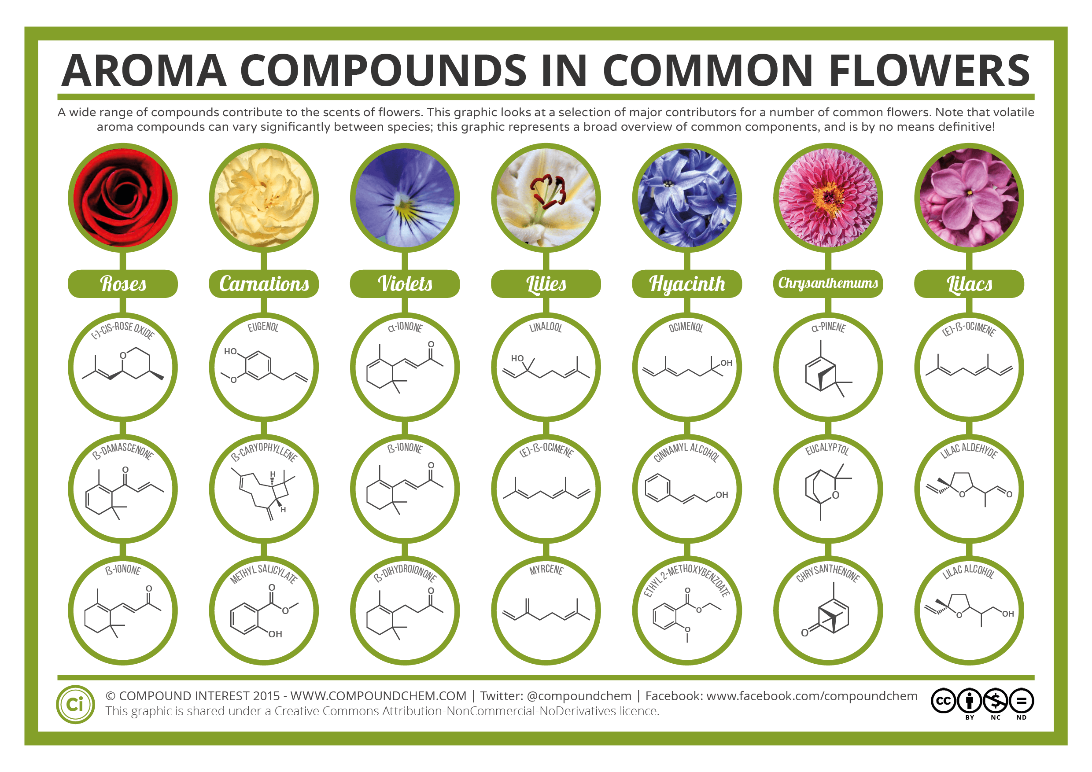
LIVING BY CHEMISTRY
SECOND EDITION
Unit 2: SMELLS
Molecular Structure and Properties
Chapter 6 Speaking of Molecules

Slide 2
In this unit you will learn:
how atoms form molecules
to predict the smell of a compound
to interpret molecular models
how the nose detects different molecules
about amino acids and proteins*
*if time permits

Slide 3
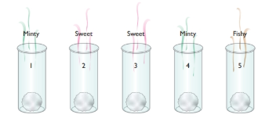
Lesson 28: Sniffing Around
Molecular Formulas

Slide 4
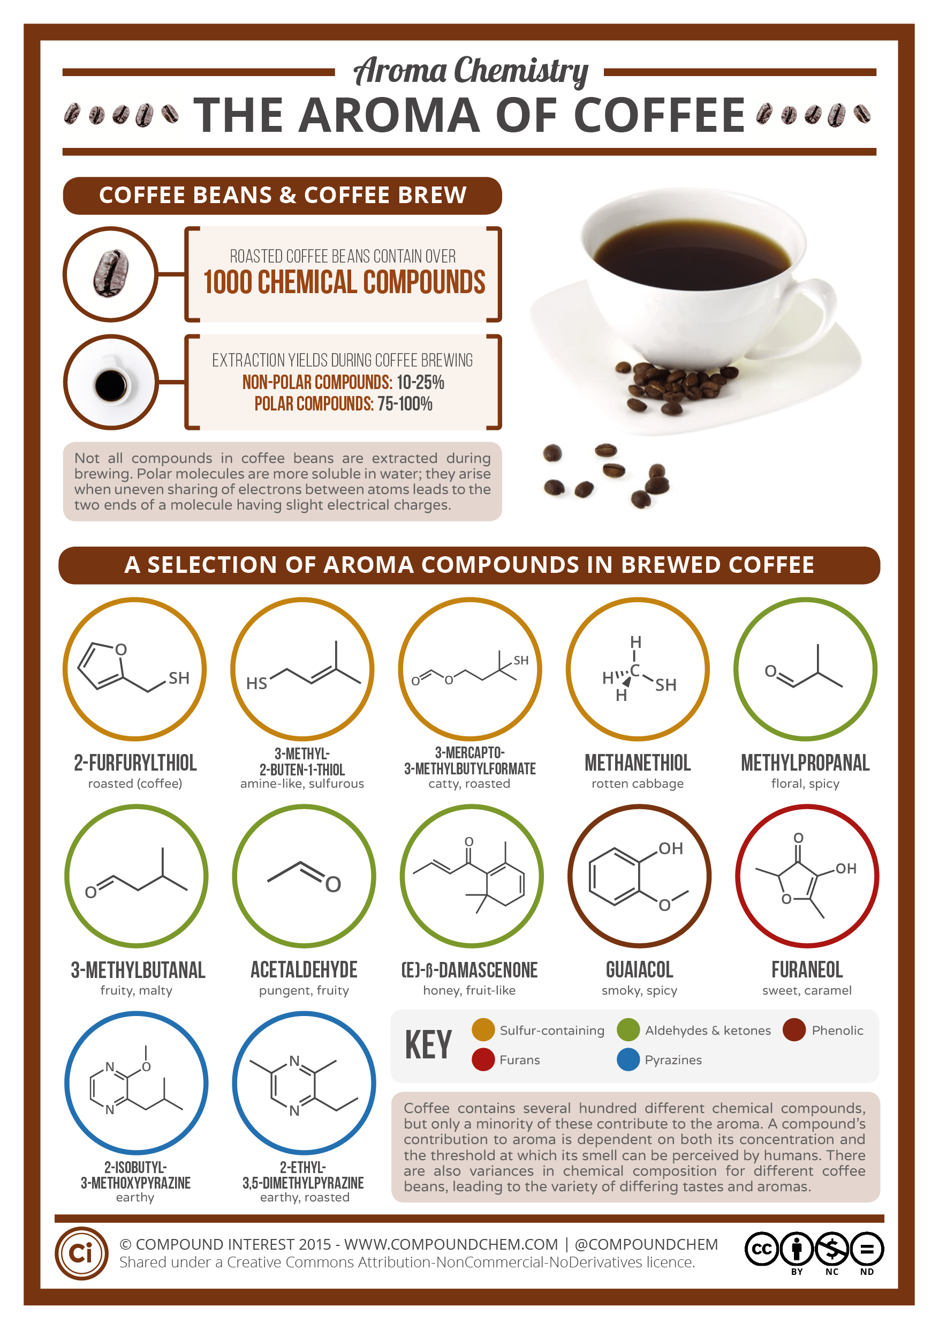
Good smells?
Notes:
https://youtu.be/R44dRIPLZGM

Slide 5
ChemCatalyst
What do you think is happening when you smell something?
Why do you think we have a sense of smell?
Notes:
Ask: Why do some things smell good and other things smell bad?
Ask: How does a smell get from one place to another?
Ask: Describe what you think your nose is detecting when you smell something. What do you think chemistry has to do with smell?

Slide 6
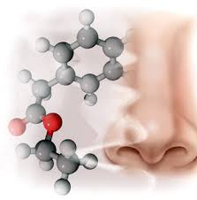
Key Question
What does chemistry have to do with smell?

Slide 7
You will be able to:
detect patterns in chemical formulas and relate these patterns to a molecular property.
create a hypothesis based on analysis of data.

Slide 8
Prepare for the Activity (1 of 2)
Work in groups of four.
Molecular formula: The chemical formula of a molecular substance, showing the types of atoms in each molecule and the ratios of those atoms to one another.
Notes:
Tell students to work in groups of four.
Tell students they will examine molecular covalent substances in this unit. These substances consist of molecules. Each molecule stays together as a unit and is represented by a molecular formula.
Review the concept of a molecule and introduce molecular formulas.

Slide 9
Prepare for the Activity (2 of 2)
Chemicals may have very strong odors or be caustic. When smelling, don’t sniff directly from the container. Instead, use a wafting technique (use your hand to draw air toward you).
Notes:
Instruct students on how to smell safely. Chemicals may have very strong odors or be caustic. Remind students to use wafting when they smell anything in the laboratory. They should use their hand to draw air toward them, not sniff directly from the container. The essences are food grade, and the smells are no stronger than those we encounter daily. However, any students with asthma or allergies should not do the smelling part of the activity.
Pass out the student worksheet.
Pass out vials A–E. Emphasize to students that they have to put the caps back on the vials immediately after smelling and not exchange caps among the vials. Before collecting the vials, tell students to tighten all the caps.

Slide 10
Your Conclusions
Mystery Smells
Which smell classification did you use for each of the five mystery smells?
Which vials would you put in the same category?
Why do you think there are sometimes disagreements over how to classify the smells of different substances?
Vial A | Vial B | Vial C | Vial D | Vial E

Slide 11
Patterns found in the Activity
Notes:
COLLECT A LIST OF PATTERNS GENERATED BY THE STUDENTS
Write the patterns on the board as the students share them.
Ask: What patterns did you discover?
Ask: According to the data, if a molecule has one oxygen atom, how would you expect it to smell? (minty) What if it has a nitrogen atom? (fi shy) What if it has two oxygen atoms? (sweet)
Ask: What other patterns help you predict the smell of a molecule?

Slide 12
Patterns found in the Activity – Teacher Only
All the molecules:
All the molecules have H and C atoms.
There are more H atoms than C atoms.
The names of molecules that have similar smells have similar endings.
Molecules that smell good all have even numbers of H atoms.
Smell seems to be related to the atoms other than C and H atoms.
Sweet-smelling molecules:
Molecules that smell sweet have two O atoms.
Molecules that end with “-ate” smell sweet.
Minty-smelling molecules:
Molecules that smell minty have one O atom and no N atoms.
Minty-smelling substances have ten C atoms and end in “-one.”
Fishy-smelling molecules:
Molecules that smell fi shy have one N atom.
The molecules with names that end with “-ine” smell fi shy.
Notes:
COLLECT A LIST OF PATTERNS GENERATED BY THE STUDENTS
Write the patterns on the board as the students share them.
Ask: What patterns did you discover?
Ask: According to the data, if a molecule has one oxygen atom, how would you expect it to smell? (minty) What if it has a nitrogen atom? (fi shy) What if it has two oxygen atoms? (sweet)
Ask: What other patterns help you predict the smell of a molecule?

Slide 13
Hypothesis
Notes:
Ask: If I gave you a new smell vial, what would you want to know about the substance inside to predict its smell?
Ask: Do you think you can predict the smell of a substance simply from knowing its chemical name and molecular formula? Why or why not?
Ask: What should we do to test this hypothesis?
Key Points: A possible hypothesis is that the smell of a substance can be predicted if you know its name and/or its chemical formula. For instance, molecules with two oxygen atoms may all smell sweet, molecules containing nitrogen may all smell fi shy, molecules containing one oxygen atom may all smell minty, molecules ending in “-ate” may all smell sweet, and so on. As students learn more about molecules and smell properties throughout the unit, they will have a chance to refine their hypotheses.

Slide 14
Discussion Notes
Another possible hypothesis is
“The smell of a substance can be predicted if you know its name and/or its chemical formula.”

Slide 15
Wrap Up
What does chemistry have to do with smell?
Smell appears to be related to molecular formula and chemical name.

Slide 16
Check-In
How would you expect a compound with the molecular formula C₈H₁₆O₂ to smell? Explain.
How sure are you of your prediction?
Notes:
Answers: 1. From the preliminary data, you can predict it will smell sweet because it has two oxygen atoms. 2. You cannot be all that sure, because you have smelled only five molecules. You have to collect more data.

Slide 17
Lesson 28 Bookwork
Read and take additional notes pages 146-150
Exercises 1-9 Complete in full sentences with thoughtful answers
Number 6 you will have to do at home ☺

