Slide 1
Unit 1 Properties of Matter
States of Matter
Classification of Matter
Properties of Matter

Slide 2
Chemistry is...
The study of matter
The study of matter

Slide 3
Matter vs. Not Matter
Can you recognize matter when you see it? What makes matter different from that which is not matter? A light bulb, for example, is matter. The electricity that makes it glow is not. What is the difference? All matter has certain characteristics in common that separate it from whatever is not matter. Can you tell which is which? Get together with your lab group and try. You will be given a card with a list of six items. Three are matter and three are not.

Slide 4
Activity
6 groups
Matter vs. Not Matter

Slide 5
. Try to classify the items on the card properly. .
Create a table in your notebook to record your results
Matter | Not Matter
1.
2.
3.
4.
5.
6.

Slide 6
Matter vs. NOT MATTER.
. Describe the characteristics all the items you classified as MATTER have in common that make them different from the items you classified as NOT MATTER.

Slide 7
Chemistry
Chemistry
The study of matter
Its composition
Its structure
The changes it undergoes
Its properties

Slide 8
Unit 1-Properties of Matter
I. States of Matter (p.12)
Kinetic Molecular Theory
States of Matter
Energy Changes

Slide 9
A. Kinetic Molecular Theory
All matter is made up of particles
Particles of matter are always in motion.
The kinetic energy (speed) of these particles increases as temperature increases.

Slide 10
State of Matter
You will now carry out an investigation into the behavior of particles (atoms or molecules) in various states of matter
We will start with some predictions and then use a PhET simulation to complete the lab

Slide 11
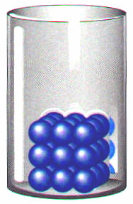
B. Four States of Matter
Solids
very low KE - particles vibrate but can’t move around
fixed shape
fixed volume

Slide 12
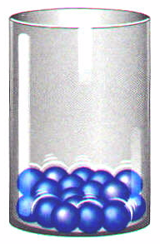
B. Four States of Matter
Liquids
low KE - particles can move around but are still close together
variable shape
fixed volume

Slide 13
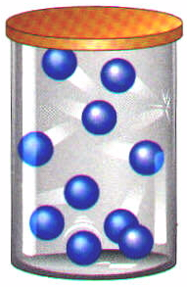
B. Four States of Matter
Gases
high KE - particles can separate and move throughout container
variable shape
variable volume

Slide 14
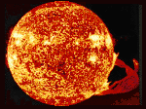
B. Four States of Matter
Plasma
very high KE - particles collide with enough energy to break into charged particles (+/-)
gas-like, variable shape & volume
stars, fluorescent light bulbs, CRTs

Slide 15
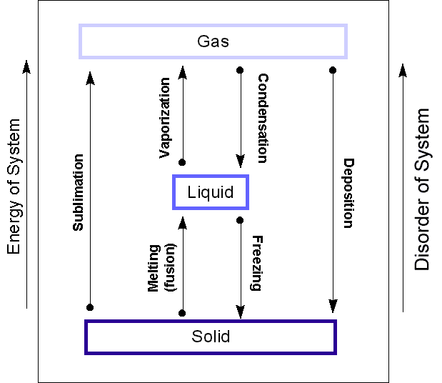
C. Changes of State

Slide 16
C. Energy Changes in Matter
when any change occurs, energy is always involved
energy can be in different forms (light, heat, etc.)
energy is never destroyed or created (law of conservation of energy)

Slide 17
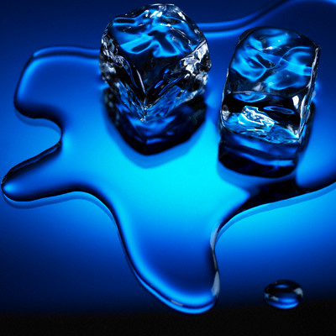
Energy Changes in Matter
Exothermic change- change that gives off energy (feels warm on outside)
Endothermic Change- change that uses up energy (feels cold on outside)

Slide 18
Now try this
Go to one of the computers and test your knowledge in this quiz – copy and past the link
http://antoine.frostburg.edu/chem/senese/101/matter/classify-matter-quiz.shtml

