Slide 1
Bond Polarity
8.4
Bonding
Ionic
Covalent

Slide 2
Bond Polarity
8.4
Bonding
Ionic
Covalent
Polar
Nonpolar

Slide 3
Bond Polarity
Ionic
Covalent
Polar
Nonpolar
Bonding
Inter-molecular
H-bonding
van der Waals forces
dipole-dipole
dispersion forces
8.4
Intra-(strong)

Slide 4
Bond Polarity
Intra-(strong)
Ionic
Covalent
Polar
Nonpolar
Bonding
H-bonding
van der Waals forces
dipole-dipole
dispersion forces
8.4
Inter-(weak)

Slide 5
IMAFs:
Intermolecular Attractive Forces
Intramolecular Attraction (within)
strong (bonds)
weak (attractions)
Intermolecular Attraction (between)

Slide 6
IMAFs: Intermolecular Attractive Forces
Intramolecular Attraction (within)
strong (bonds)
weak (attractions)
Intermolecular Attraction (between)
IMAFs determine physical properties like:
state (solid/liquid/gas), bp’s, mp’s, viscosity…

Slide 7
Bond Polarity
Intra-(strong)
Ionic
Covalent
Polar
Nonpolar
Bonding
Inter-(weak)
8.4
van der Waals forces
dispersion forces

Slide 8
van der Waals Forces
dispersion forces
temporary dipoles caused by
the motion of e–’s
nonpolar
δ⁺
δ–

Slide 9
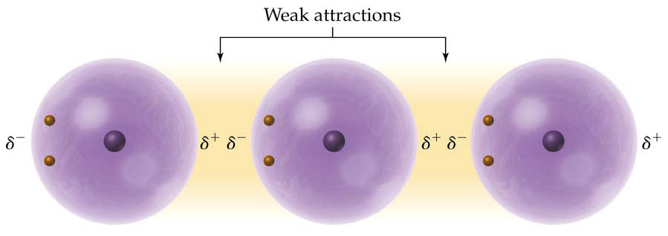
van der Waals Forces
dispersion forces
temporary dipoles caused by
the motion of e–’s
weakest IMAF’s
nonpolar
δ–
δ⁺
δ–
δ⁺
δ–
δ⁺

Slide 10
Bond Polarity
Intra-(strong)
Ionic
Covalent
Polar
Nonpolar
Bonding
Inter-(weak)
van der Waals forces
8.4
dipole-dipole forces
dispersion forces

Slide 11
Bond Polarity
Intra-(strong)
Ionic
Covalent
Polar
Nonpolar
Bonding
Inter-(weak)
van der Waals forces
8.4
H-bonds
dipole-dipole forces
dispersion forces

Slide 12
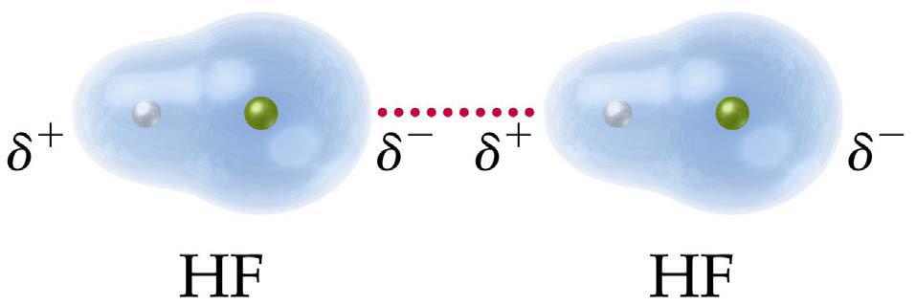
van der Waals Forces
dipole–dipole forces
permanent dipoles from
polar molecules
H
Cl
H
Cl

Slide 13
Bond Polarity
Intra-(strong)
Ionic
Covalent
Polar
Nonpolar
Bonding
Inter-(weak)
van der Waals forces
8.4
H-bonds
dipole-dipole forces
dispersion forces

Slide 14
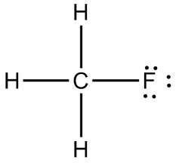
Hydrogen Bonding
δ⁺
δ–
δ⁺
δ–
NH₃
δ⁺
δ⁺
H₂S
H-bonds are caused by an electron deficient H atoms (bonded to N, O, or F) attracted to small, very electronegative N, O, or F atoms on a nearby molecule.
H-bonds are the strongest IMAF
CH₄
CH₃F
√
HF
√
CH₃OH

Slide 15
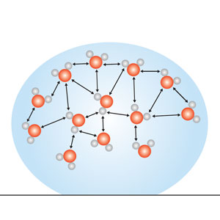
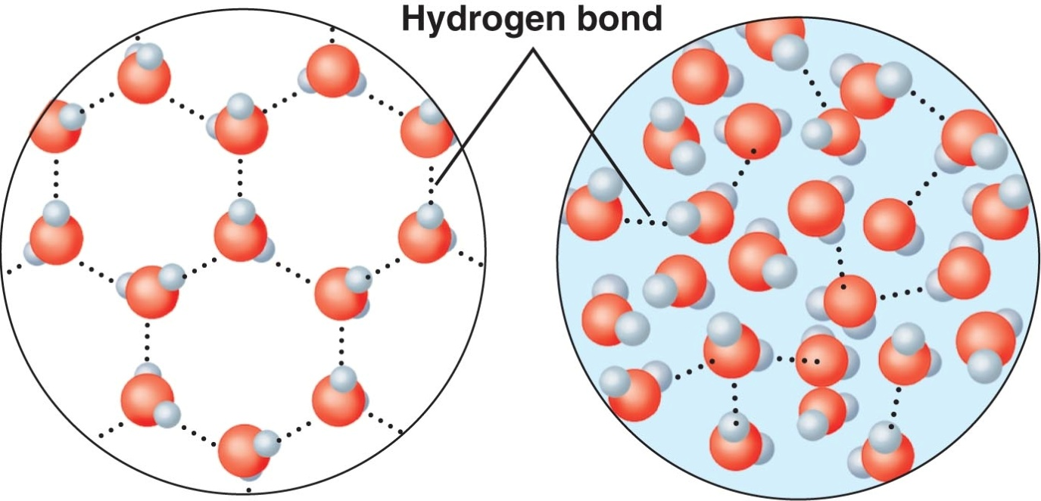
Special Properties of Water
caused by strong attractions:
(hydrogen bonding)
higher bp (liquid)
(100ºC instead of –70ºC)
surface tension (bead)
density: solid < liquid

Slide 16
Intermolecular Attractive Forces
Stronger
Weaker
H-bonds
(H with N, O, or F)
dipole-dipole
(polar molecules)
dispersion forces
(nonpolar, temp. dipoles from e– motion)

Slide 17
Quick Quiz!
1. Which of the following IMAF’s is caused by the motion of electrons?
polar bonds
dispersion forces
dipole–dipole forces
hydrogen bonds

Slide 18
Quick Quiz.
2. Which of the following bond types is the strongest bond?
dipole–dipole forces
dispersion forces
covalent bonds
hydrogen bonds
strongest IMAF!!!

Slide 19
Quick Quiz.
3. Molecules have hydrogen bonding when a hydrogen atom is…
attracted to other ions
affected by the motion of electrons
shared with electron pairs
bonded to N, O, or F and attracted to a small, very electronegative atom on an neighboring molecule

Slide 20
Quick Quiz.
4. Which of the following is caused by H-bonding in water?
low density
electrical tension
higher boiling point
dispersion forces
(liquid at room temp)

