Slide 1
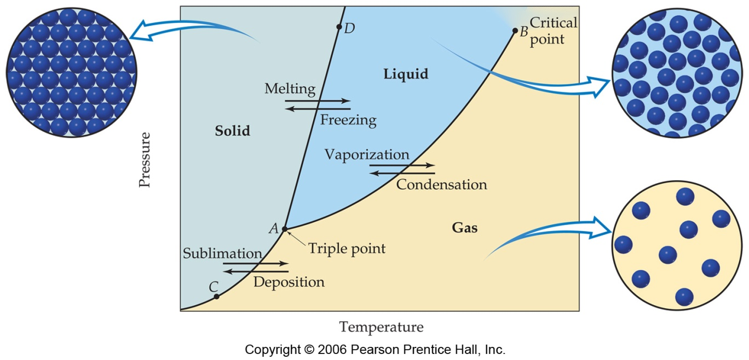
Phase Diagrams:
represent phases dependent on pressure and temperature.
liquid
solid
Pressure
gas
Temperature

Slide 2
Triple Point (A):
T & P with all 3 states exist in equilibrium
liquid
solid
Pressure
triple point
gas
Temperature
Notes:
p.463

Slide 3
supercritical fluid
Critical Point (B):
above T no liquid can exist (too energized)
above P no gas can exist (too compressed)
liquid
solid
critical point
Pressure
gas
Temperature
Notes:
p.463

Slide 4
liquid-vapor equilibrium (AB line):
every point along line is the boiling point (at that pressure)
liquid
=T↓P
solid
Pressure
=P , ↑T
gas
Temperature
Notes:
p.463

Slide 5
solid-liquid equilibrium (AD line):
every point along line is the melting point
(at that pressure)
(freezing)
=P , ↑T
liquid
solid
Pressure
=T↓P
gas
Temperature

Slide 6
solid-gas equilibrium (AC line):
every point is sublimation point
below A liquid cannot exist at such low pressure
liquid
solid
Pressure
gas
Temperature

Slide 7
Phase Diagram of CO₂ :
low critical point
(31.1ºC & 73 atm)
supercritical CO₂ is a good nonpolar solvent for nonpolar substances (like caffeine)
=P , ↑T
CO₂ sublimes at normal pressures
(1 atm)

Slide 8
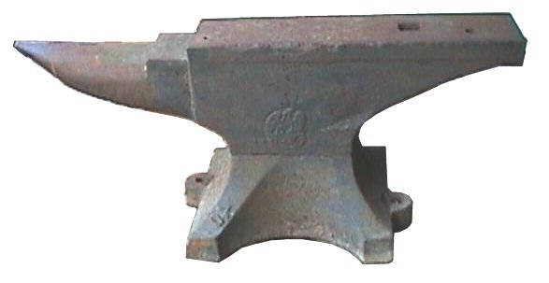
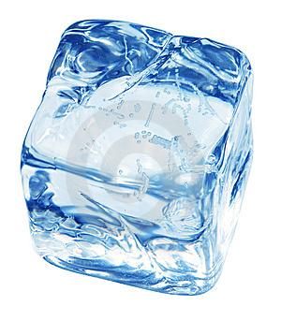
Phase Diagram of Water:
high critical point
(374ºC & 218 atm)
strong IMAF’s (H-bonds)
solid-liquid line of negative slope
Why?
Why?
liquid more dense than solid, so…
=T↑P
0.006
atm
melted by “squeezing”

Slide 9
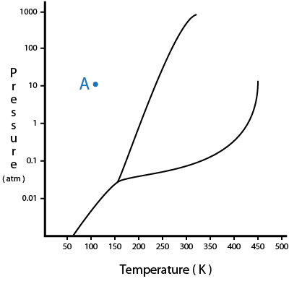
Quick Quiz!
1. In the phase diagram, which region is the gas?
X
Y
Z
X
Y
Z

Slide 10
Quick Quiz.
2. Which point is the boiling point?
1
2
3
4
5
5
X
Y
1
2
4
Z
3

Slide 11
Quick Quiz.
3. Point 4 is the ___________ point.
freezing
melting
triple
critical
5
X
Y
1
2
4
Z
3

