Slide 1
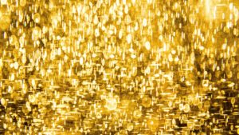
LIVING BY CHEMISTRY
SECOND EDITION
Unit 1: ALCHEMY
Matter, Atomic Structure, and Bonding

Slide 2
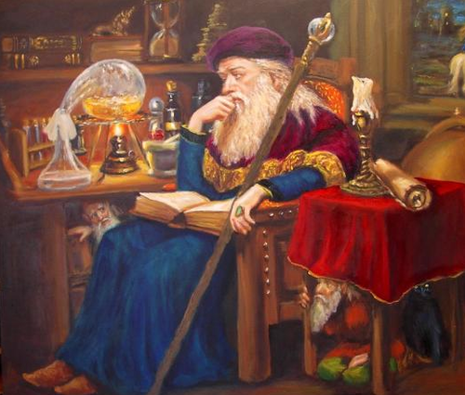
Lesson 2: A Penny for Your Thoughts
Introduction to Chemistry

Slide 3
ChemCatalyst
Long ago, early scientists tried to turn ordinary things into gold. This pursuit was called alchemy, and the people who engaged in alchemy were called alchemists.
Do you think these early scientists were successful in turning things into gold? Explain your thinking.

Slide 4
Key Question
What is chemistry?

Slide 5
You will be able to:
observe a procedure and write observations.
define and formulate a hypothesis to explain observed phenomena.
define chemistry and begin to describe what chemists study.

Slide 6
Prepare for the Demonstration
In this demo, you will observe a chemical transformation firsthand.
Notes:
What did you observe in the demonstration?
What do you think happened to change the penny to silver
To gold?
DO you think the penny was changed into real gold? Why or why not? How could you find out?

Slide 7
Discussion Notes (1 of 3)
To determine whether the new penny is gold, you need to study its properties.
Property: A characteristic of a substance.
Physical Properties: color, hardness, size, weight
Chemical Properties: how a substance reacts

Slide 8
Discussion Notes (2 of 3)
Chemistry: The study of substances, their properties, and how they can be transformed. The study of matter and how matter can be changed.

Slide 9
Discussion Notes (3 of 3)
Scientists use a systematic approach to solve problems in science.
Hypothesis: A testable explanation for an observation.

Slide 10
Wrap Up
What is chemistry?
Chemistry is the study of what substances are made of, how they behave, and how they can be transformed. It is the study of matter and how matter can be changed.
A hypothesis is a testable explanation for an observation.
Scientists use a systematic approach to solving problems in science.

