Slide 1
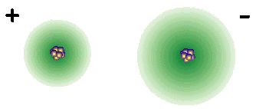
II. Ionic Compounds (p. 176 – 180, 203 – 211)
Unit 6 - Chemical Bonding

Slide 2
Ionic Bonding forms Ionic Compounds
Anions and cations are held together by opposite charges (+ and -)
Ionic compounds are called salts.
Simplest ratio of elements in an ionic compound is called the formula unit.
The bond is formed through the transfer of electrons (lose and gain)
Electrons are transferred to achieve noble gas configuration.

Slide 3
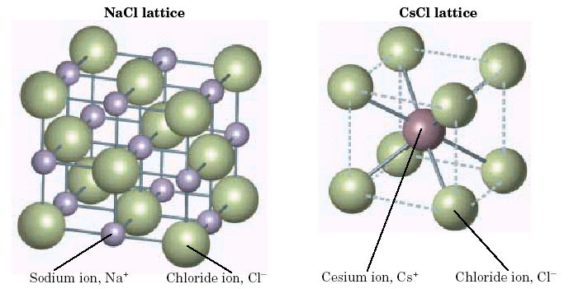
A. Energy of Bond Formation
Lattice Energy
Energy released when one mole of an ionic crystalline compound is formed from gaseous ions

Slide 4
Structure of Ionic Compounds
Coordination number for both the sodium and chlorine in salt is 6
Each ion is surrounded by 6 oppositely charged ions
Salt crystals have a cubic shape

Slide 5
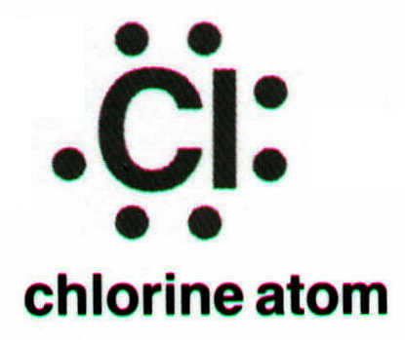
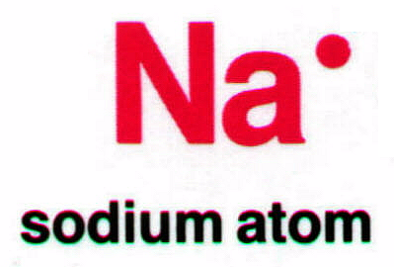
B. Lewis Structures
Covalent – show sharing of e⁻
Ionic – show transfer of e⁻

Slide 6
B. Lewis Structures
Covalent – show sharing of e⁻
Ionic – show transfer of e⁻

Slide 7
Quiz
An ionic bond results from the electrical attraction between
a. cations and anions
b. atoms
c. dipoles
d. orbitals

Slide 8
Quiz
The principle that states that atoms tend to form compounds in which each atom has 8 electrons in its highest occupied energy level is
a. the rule of eights
b. configuration rule
c. Avogadro’s principle
d. octet rule

Slide 9
Quiz
The notion for sodium chloride, NaCl, stands for one
a. formula unit
b. molecule
c. crystal
d. ion

Slide 10
Quiz
Compared with the energies of the atoms that form the ions, a crystal lattice has
a. Zero potential energy
b. higher potential energy
c. lower potential energy
d. equal potential energy

Slide 11
Quiz
Compared to solid ionic compounds, molecular compounds generally
a. have lower melting points
b. are more brittle
c. are harder
d. conduct electricity as liquids

Slide 12
Quiz
The salts NaCl (s) and CaCl₂ (s)
a. are good conductors of electricity
b. are positively charged
c. are held together by ionic bonds
d. Both (a) and (b)

Slide 13
Quiz
A charged group of covalently bonded atoms is known as a(n)
a. anion
b. polyatomic ion
c. formula unit
d. cation

Slide 14
Quiz
Because strong attractive forces hold the layers in an ionic crystal in relatively fixed positions, ionic compounds
a. are hard
b. are brittle
c. are not electrical conductors as solids
d. all of the above

Slide 15
QUIZ
In a crystal of sodium chloride, how many oppositely charged ions does each Na⁺ and Cl⁻ ion have clustered around it?
a. 1
b. 2
c. 4
d. 6

