Slide 1
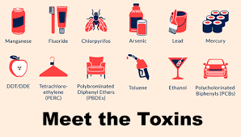
LIVING BY CHEMISTRY
March _______
Unit 4: TOXINS
Stoichiometry, Solution Chemistry, and Acids and Bases
Chapter 15 “Toxins in Solution”
Notes:
In this chapter, students will learn
definitions of the terms solute, solvent, saturated solution, concentration, and molarity
how to create a solution with a specific molarity
how to calculate the number of moles or grams in a solution sample
the difference between number density and mass density in a solution
the proportional relationship between moles and liters

Slide 2
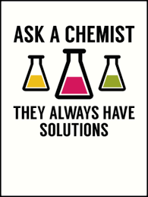
Lesson 80: Bearly Alive
Solution Concentration
Notes:
KEY IDEAS
A solution is a mixture of two or more substances that is uniform throughout. The dissolved substance is generally referred to as the solute, and the medium the substance is dissolved in is called the solvent. The concentration of a liquid solution is a measure of the number of moles of a dissolved substance per liter of solution. The concentration of a solution is a measure of number density, n/V, called the molarity of the solution.

Slide 3
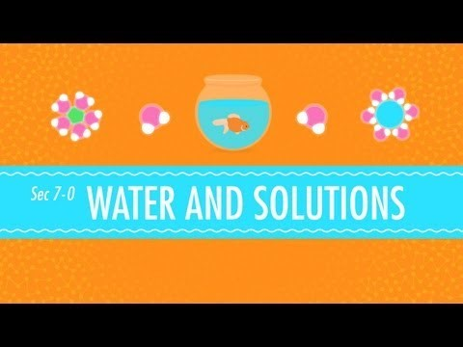
Watch the following introduction
https://youtu.be/AN4KifV12DA Crash Course Chemistry Episode 7 “Water and Solutions” click the link above

Slide 4
ChemCatalyst
Five gummy bears have been placed overnight in five different aqueous sugar solutions. Each solution contains a different amount of dissolved sugar.
Which solution do you think has the greatest amount of sugar in it? Explain your reasoning.
What do you think caused the bears to change size?
Notes:
Sample answers: 1. Some students may say the corn syrup has the most sugar because it looks syrupy. Some may say the solution that caused the bear to expand the most has the most sugar, while others may say the solution that caused the bear to shrink has the most sugar. 2. Students may hypothesize that the bears changed size because water moved into them or because sugar moved into them. It is the water that is moving in or out of the bears.
Ask: How would you describe the gummy bears?
Ask: What do you think happened to the bears?
Ask: How does the amount of sugar in each solution vary? Explain your thinking.
Ask: Which solution do you think has the greatest number of sugar molecules per volume? Explain.

Slide 5
Key Question
How can you keep track of compounds when they are in solution?

Slide 6
You will be able to:
define the terms solution, saturated solution, solute, and solvent
explain what the concentration and molarity of a solution represent
complete calculations involving molarity

Slide 7
Prepare for the Activity
Solution: A mixture of two substances that is uniform throughout.

Slide 8
Discussion Notes (1 of 5)
A solution is a mixture of two or more substances that is uniform throughout.
Solute: The substance dissolved in a solution.
Solvent: The substance in which the solute dissolves in a solution.

Slide 9
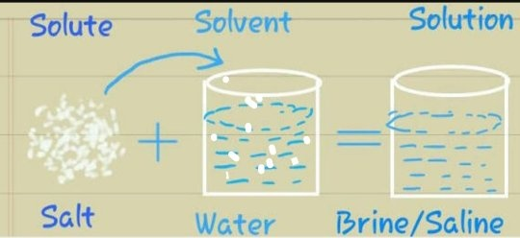
visual

Slide 10
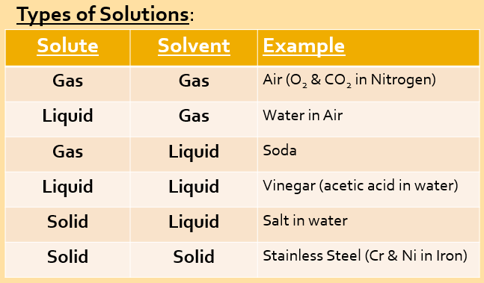
Here of some examples of different types of solutions all around us.

Slide 11
For this activity you will find examples of solutions in or around your home. Add this table to you Assignment in Google Classroom
Solute | Solvent | Solution

Slide 12
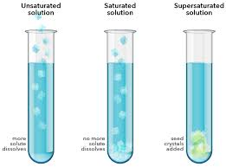
Watch the Video
“What Happens When Stuff Dissolves” https://youtu.be/0cPFx0wFuVs

Slide 13
Discussion Notes (2 of 5)
A solution is saturated when no more solute will dissolve.
Saturated solution: A solution that contains the maximum amount of solute for a given amount of solvent.

Slide 14
Discussion Notes (3 of 5)
Concentration refers to the amount of solute that is dissolved in a solution.
Concentration: A measure of the amount of solute dissolved in a specified volume of solution.

Slide 15
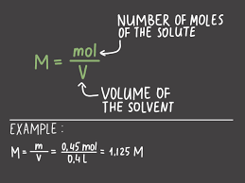
Discussion Notes (4 of 5)
Molarity: The concentration of a solution expressed in moles of solute per liter of solution.

Slide 16
Discussion Notes (5 of 5)
The gummy bears changed size depending on the concentration of the solution they were soaked in.
Molecules move from areas of higher concentration to areas of lower concentration.

Slide 17
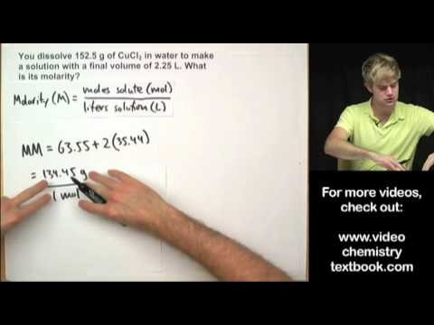
Video Tutorial – Calculating Molarity
Molarity Practice Problems Video Tutorial –click on the link to watch each
Part 1: https://youtu.be/SXf9rDnVFao
Part 2: https://youtu.be/sWfn8hbXRp8

Slide 18
Wrap Up
How can you keep track of compounds when they are in solution?
When two or more substances mix together uniformly at a molecular, ionic, or atomic level, they form a solution.
The concentration of a solution can be expressed in moles per liter. This is also called the molarity of the solution, or M.
The concentration of a solution can also be expressed in moles per kilogram.
This is called the molarity of the solution, or m.

Slide 19
Check-In
Suppose 10.0 g of salt, NaCl, are dissolved in 0.50 L of water. What is the molarity of this solution? (Hint: 1st convert grams of salt to moles, 2nd divide moles by the liters of solution)
Notes:
Answer: Determine the number of moles of salt and divide by the volume of solution in liters: 10.0 g/58.45 g/mol = 5 0.17 mol; 0.171 mol/0.50 L= 5 0.34 mol/L, or 0.34 M.

Slide 20
Check-In Answer
Suppose 10.0 g of salt, NaCl, are dissolved in 0.50 L of water. What is the molarity of this solution? (Hint: 1st convert grams of salt to moles, 2nd divide moles by the liters of solution)
Answer: Determine the number of moles of salt and divide by the volume of solution in liters:
10.0 g/58.45 g/mol = 0.171 mol;
0.171 mol/0.50 L= 5 0.34 mol/L, or 0.34 M.
Notes:
Answer: Determine the number of moles of salt and divide by the volume of solution in liters: 10.0 g/58.45 g/mol = 0.171 mol; 0.171 mol/0.50 L= 5 0.34 mol/L, or 0.34 M.

Slide 21
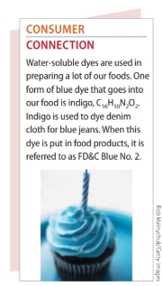
Bookwork/Homework
Assignment in Google Classroom to fill out online
Read pages 407 – 412
Exercises 1-10 answer in the Google Doc in classroom

