Slide 1
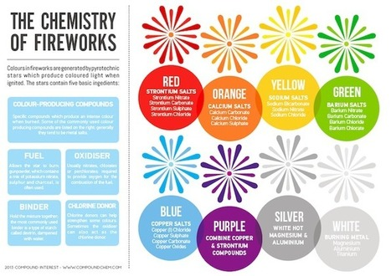
Infographic: a visual presentation of information in the form of a chart, graph, or other image accompanied by minimal text, intended to give an easily understood overview, often of a complex subject
Infographic Design
Assignment
Example Infographic

Slide 2
Go to the Chemistry 2016-2017 page at msrobbinspnhs.weebly.com to find pdf versions of chapters 10 and 11. Choose 1 whole Section from either chapter to use as the basis for your infographic.
Create your own infographic about Gases using information from the section of text you choose.
On the computer you can use a template from Pictochart. You should share a copy of this or the link with me @ erobbins@plymouth.k12.ma.us
You may make one by hand but you will have to neatly plan out your visuals and words, use rulers and include color. See me for paper and supplies.

Slide 4
Study the Making Chemical Reactions Happen Faster Infographic found on the Chemistry 2016-2017 page at msrobbinspnhs.weebly.com
Now Create your own infographic about Energy and Chemical Reactions using information form Section 1 of your Notebook.
On the computer you can use a template from Pictochart. You should share a copy of this or the link with me @ erobbins@plymouth.k12.ma.us
You may make one by hand but you will have to neatly plan out your visuals and words, use rulers and include color. See me for paper and supplies.

