Slide 1
Drawing atoms and ions

Slide 2
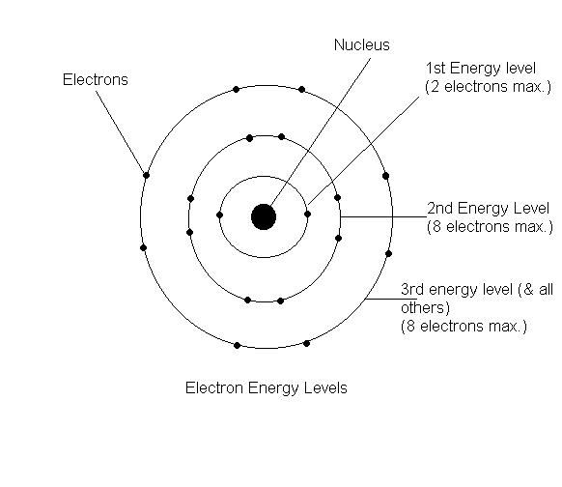
Bohr Model

Slide 3
Bohr’s model
Energy level of an electron
analogous to the rungs of a ladder
The electron cannot exist between energy levels, just like you can’t stand between rungs on a ladder
A quantum of energy is the amount of energy required to move an electron from one energy level to another

Slide 4
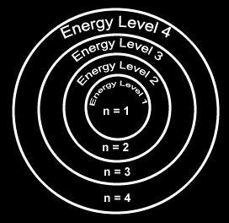
Principal Quantum Number
Generally symbolized by “n”, it denotes the shell (energy level) in which the electron is located.
Maximum number of electrons that can fit in an energy level is:
2n²
How many e⁻ in level 2? 3?

Slide 5
Valence Electrons are…?
The electrons responsible for the chemical properties of atoms, and are those in the outer energy level.
Valence electrons - electrons in the outer energy level
the highest occupied energy level
Core or inner shell electrons – are those in the energy levels below.

Slide 6
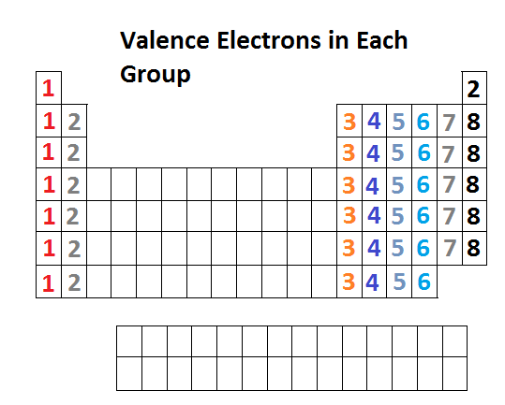
Keeping Track of Electrons
Atoms in the same column...
Have the same outer electron configuration.
Have the same valence electrons.
The number of valence electrons are easily determined. It is the group number for a representative element
Group 2(2A): Be, Mg, Ca, etc.
have 2 valence electrons

Slide 7
Valence Electrons
The electrons in the highest energy level of an atom that take part in reactions
determine how the atom reacts chemically with other atoms.
Draw Li and Na; identify their valence electrons
What happens when these elements form an ion?

Slide 8
Electron Dot diagrams are…
A way of showing & keeping track of valence electrons.
How to write them?
Write the symbol - it represents the nucleus and inner (core) electrons
Put one dot for each valence electron (8 maximum)
They don’t pair up until they have to (Hund’s rule)
X

Slide 9
The Electron Dot diagram for Nitrogen
Nitrogen has 5 valence electrons to show.
First we write the symbol.
N
Then add 1 electron at a time to each side.
Now they are forced to pair up.
We have now written the electron dot diagram for Nitrogen.

Slide 10
The Octet Rule
We learned that noble gases are unreactive in chemical reactions
In 1916, Gilbert Lewis used this fact to explain why atoms form certain kinds of ions and molecules
The Octet Rule: in forming compounds, atoms tend to achieve a noble gas configuration; 8 in the outer level is stable
Each noble gas (except He, which has 2) has 8 electrons in the outer level

Slide 11
Electron Dots For Cations
Metals lose electrons to attain a noble gas configuration.
They make positive ions (cations)
Ca

Slide 12
Electron Dots For Cations
Metals will have few valence electrons
Metals will lose the valence electrons
Ca

Slide 13
Electron Dots For Cations
Metals will have few valence electrons
Metals will lose the valence electrons
Forming positive ions
Ca²⁺
This is named the “calcium ion”.
NO DOTS are now shown for the cation.

Slide 14
Electron Dots For Anions
Nonmetals gain electrons to attain a noble gas configuration.
They make positive ions (anions)
Cl

Slide 15
Electron Dots For Anions
Nonmetals gain electrons to attain a noble gas configuration.
They make negative ions (anions)
Cl ⁻¹
This is named the “chloride ion”
8 DOTS are now shown for the anion.

Slide 16
https://www.dropbox.com/s/2a6b4avxohx6nbs/Post-Lab_Questions_ItC.docx?dl=0

