Slide 1
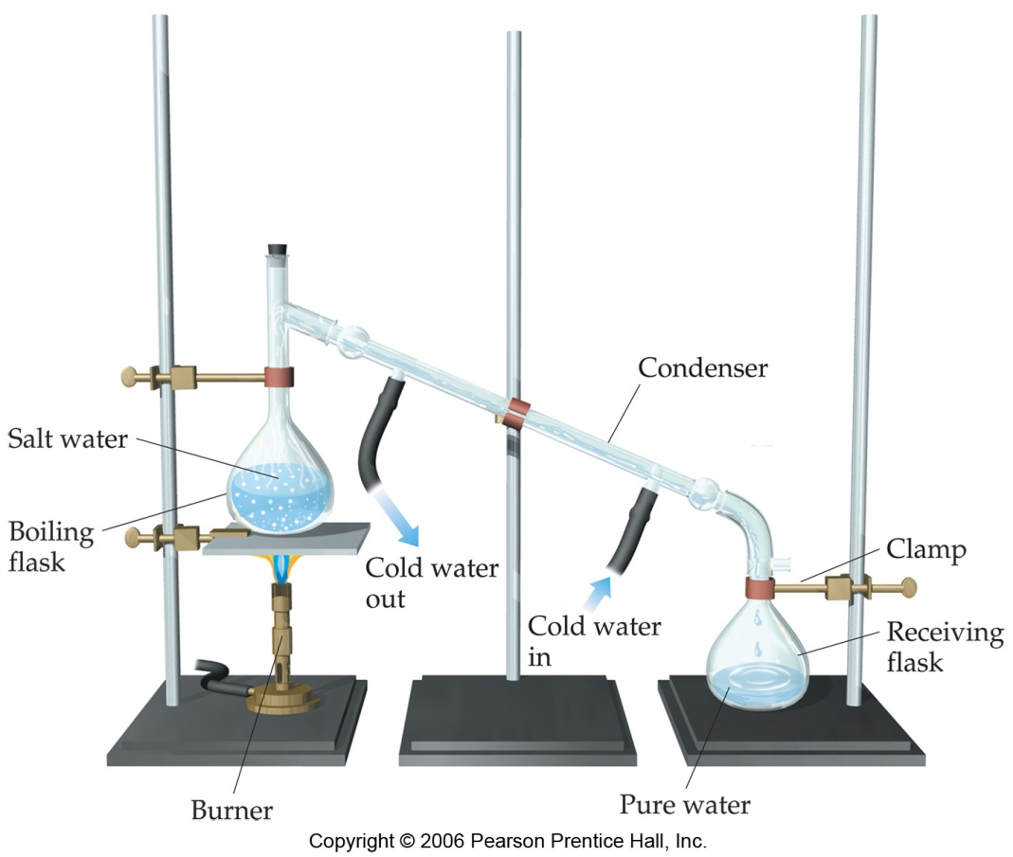
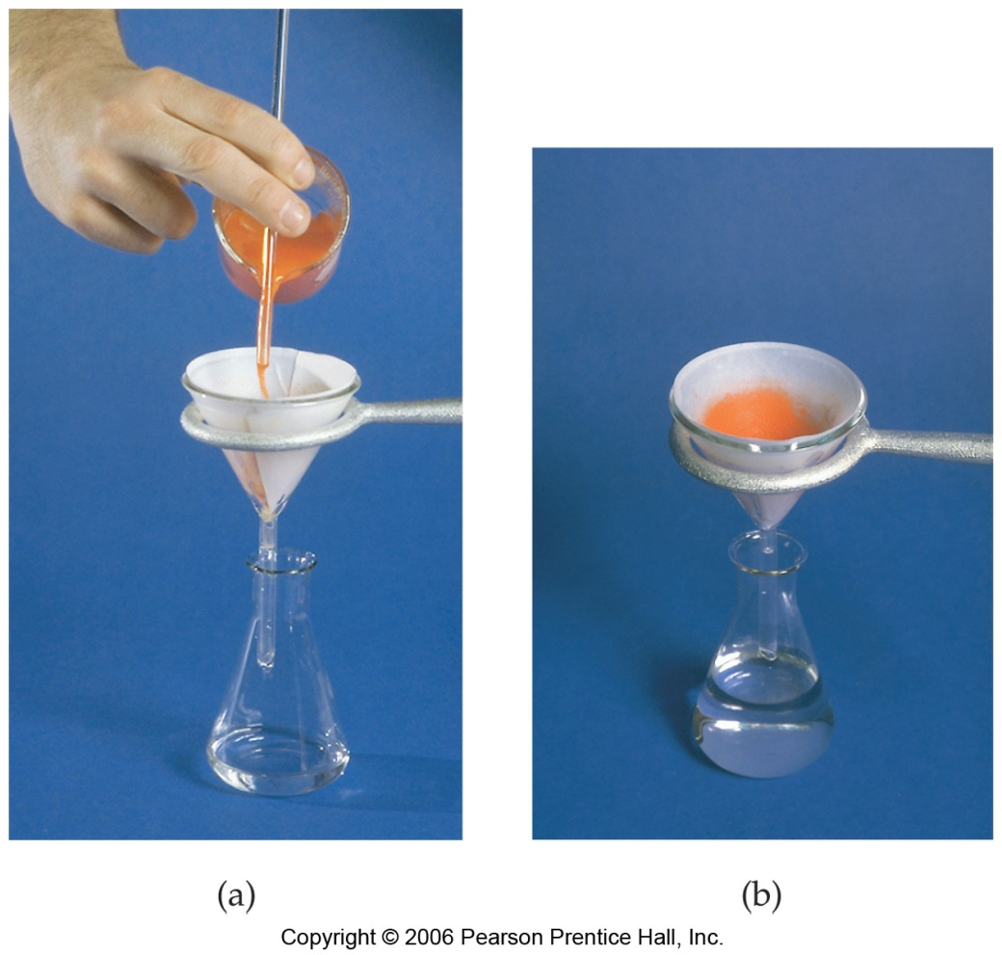
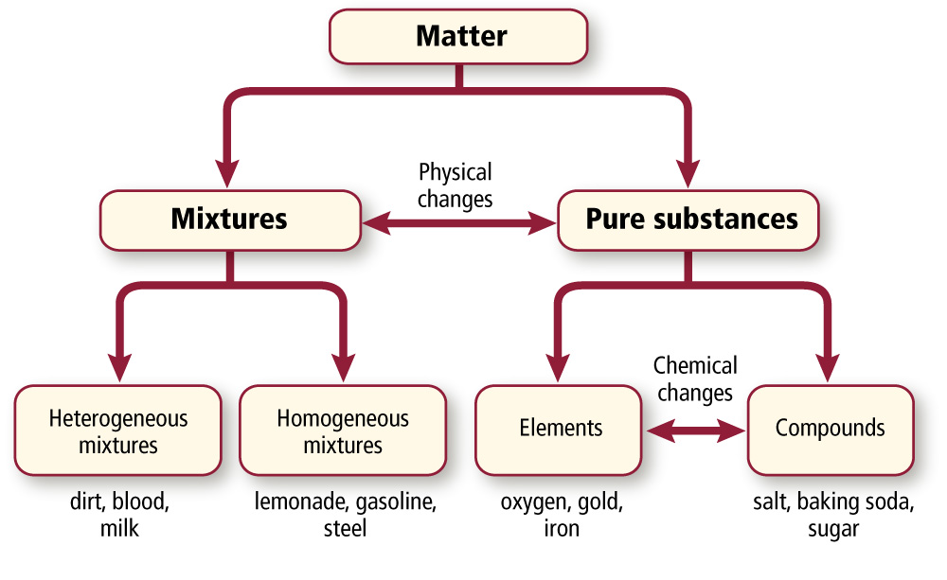
Matter
distillation
(boiling)
cannot separate physically
separate physically
Physical
changes
Mixture
Pure Substance
differences or unevenly mixed
uniform or evenly mixed
separate chemically
cannot separate
filtering
Chemical
changes
Heterogeneous Mixture
Homogeneous Mixture
Compounds
Elements
salt, baking soda, water, sugar
oxygen, iron, hydrogen, gold
(uneven, differences)
(solutions)
NaCl NaHCO₃
H₂O C₁₂H₂₂O₁₁
O₂ Fe
H₂ Au
Notes:
Classification of Matter (flowchart handout)
Sugar and Water make Lemonade
Sugar and Water and Fat make Milk
Sugar and Salt and Water and Fat and Iron and Oxygen make Blood

Slide 2

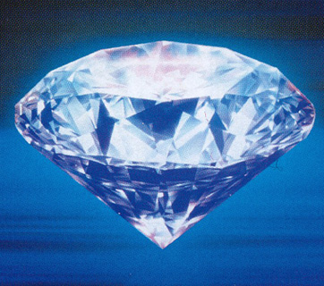
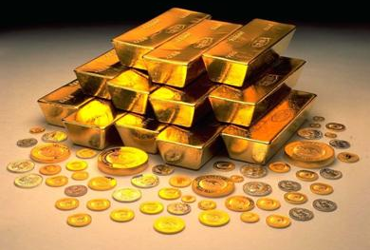
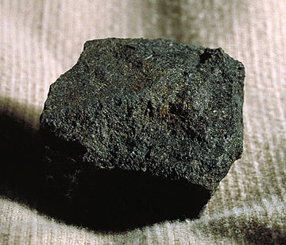
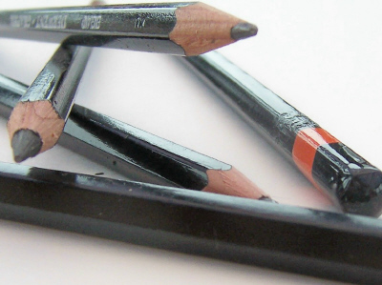
Pure Substances
Element:
-only one type of atom
-simplest form of matter retaining its properties
(cannot be separated)
(chemically or physically)
Examples:
Carbon (C)
Helium (He)
Gold (Au)

Slide 3
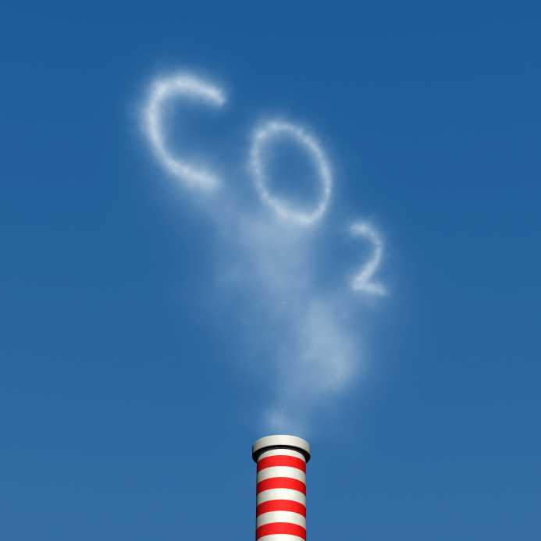
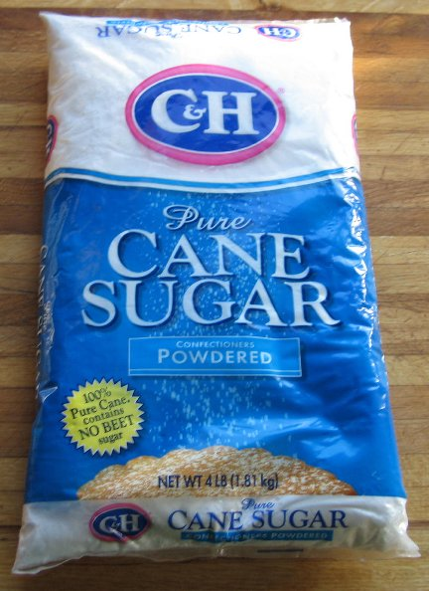
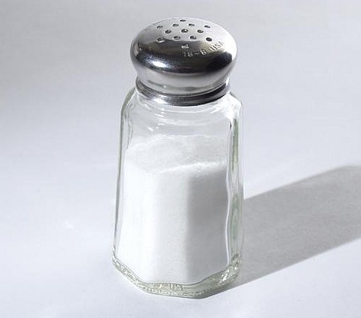
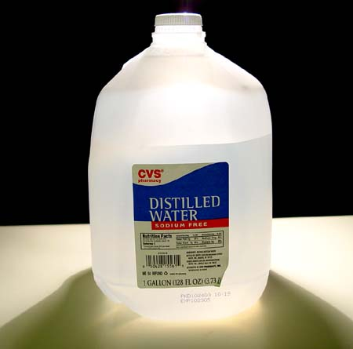
Pure Substances
Compound:
different elements chemically bonded together
(can be separated…
chemically)
Examples:
Carbon Dioxide (CO₂)
Water (H₂O)
Salt (NaCl)
Sucrose (C₁₂H₂₂O₁₁)

Slide 4
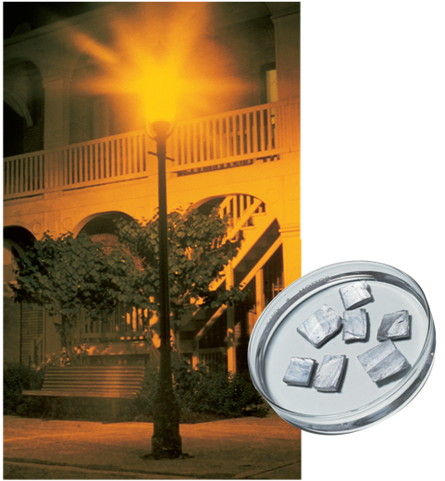
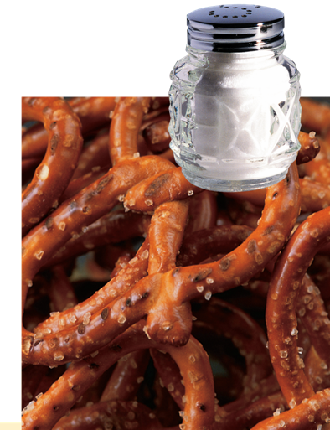
    completely new substance with completely new properties
    NaCl
    (compound)
Na (element)
    Sodium is a highly reactive metal stored in oil.
Cl₂ (element)
    Chlorine kills organisms in pools.
    It’s also a poisonous green gas.

Slide 5
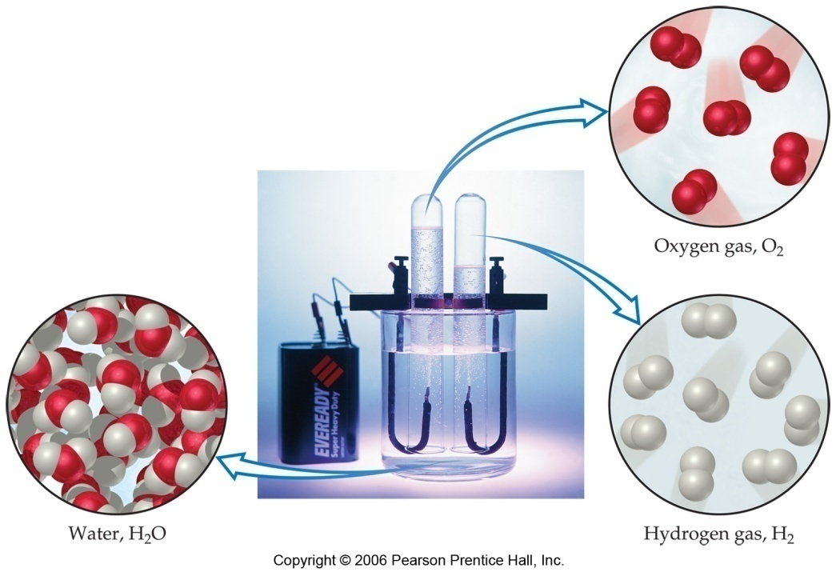
Compound:
can be separated…
chemically into…
…which can…
NOT.
elements
O₂
(gas)
H₂O
(liquid)
H₂
(gas)
Hoffman apparatus

Slide 6
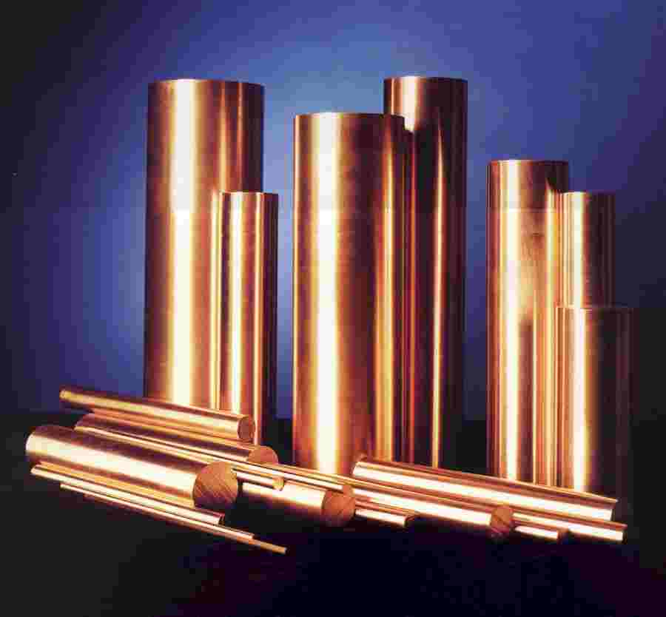
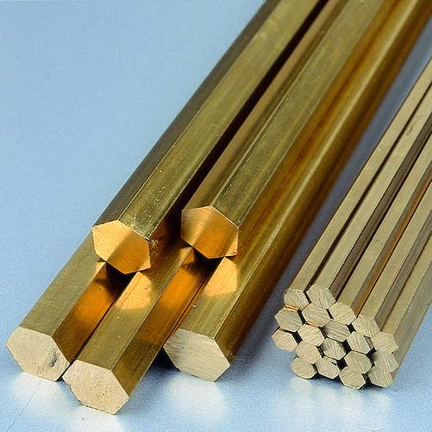
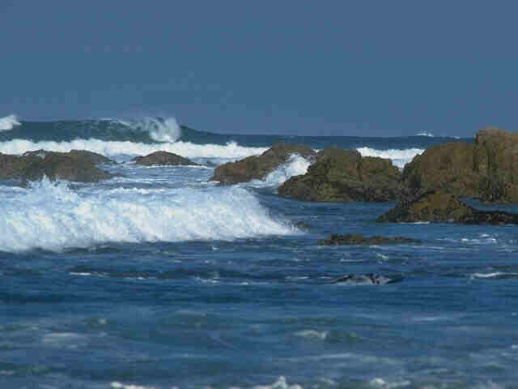
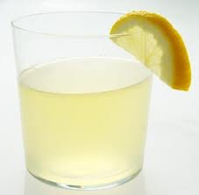
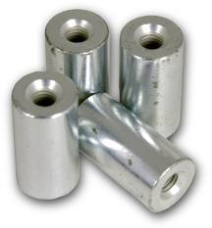
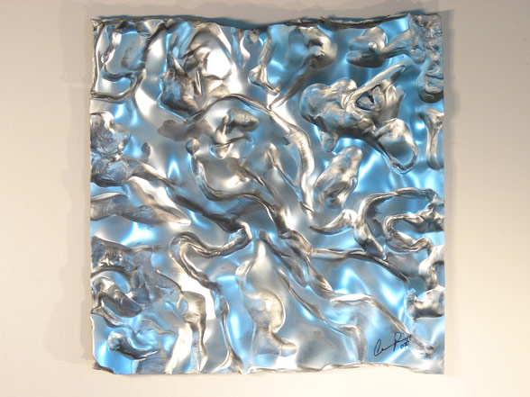
Mixtures
(Solution)
physically separated by _____________.
distillation
Homogeneous Mixture:
physically mixed evenly…
it looks the same throughout
(boiling)
Examples:
Copper (Cu) and Zinc (Zn) make brass.
lemonade
Steel (Fe + C + Cr)
NaCl + H₂O → salt water

Slide 7
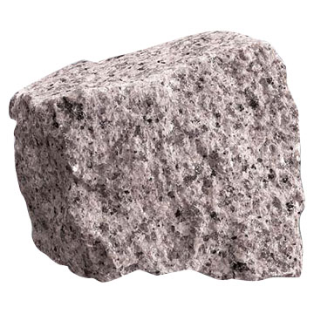
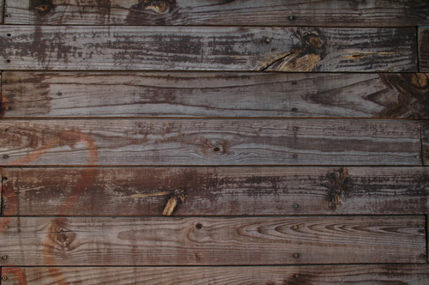
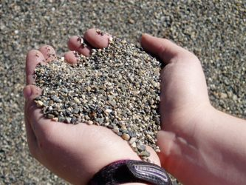
Mixtures
Heterogeneous Mixture:
physically mixed unevenly…
can see the different parts
Examples:
Sand
Granite
Wood
2 Types:
Suspensions & Colloids

Slide 8
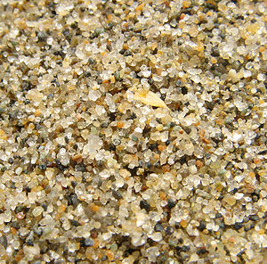
Separation (Group Discussion)
Sand + Iron (Fe) + Salt (NaCl) is a(n)
______________________ that can be
separated by …
heterogeneous mixture
Physically:
-pulling out Fe with magnet
Physically:
-dissolving NaCl in water
-filtering sand out
-evaporating the water
Chemically:
-decomposing NaCl with electricity into Na and Cl
Notes:
Give students 3 min discuss in small groups how this mixture might be separated. Give 3 min to share. Then reveal.

Slide 9
Quick Quiz!
  Passing an electric current through a substance produces oxygen and sulfur.
  This substance cannot be a(n)
    compound.
    mixture.
    element.
    solution.

Slide 10
Quick Quiz.
  2. Which of the following is a mixture?
    sodium chloride (NaCl)
    carbon dioxide (CO₂)
    sucrose (sugar, C₁₂H₂₂O₁₁)
    air (N₂, O₂, CO₂, H₂, Ar, …)

Slide 11

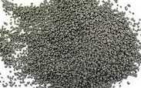
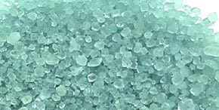
Quick Quiz.
+
  A blue-green solid is decomposed by heating.
  A colorless gas and a black solid appear.
  The blue-green solid must have been a(n)
    heterogeneous mixture
    homogeneous mixture
    compound
    element

Slide 12
Matter
distillation
(boiling)
________ separate physically
separate physically
________
changes
_______
_____ Substance
separate chemically
cannot separate
_________
_______
filtering
________
changes
______geneous Mixture
_____geneous Mixture
__________
________
salt, baking soda, sugar, water
oxygen, iron, hydrogen, gold
(uneven, differences)
(________)
NaCl NaHCO₃
H₂O C₁₂H₂₂O₁₁
O₂ Fe
H₂ Au
Notes:
Classification of Matter (flowchart handout)
Sugar and Water make Lemonade
Sugar and Water and Fat make Milk
Sugar and Salt and Water and Fat and Iron and Oxygen make Blood

