Slide 1
LIVING BY CHEMISTRY
Unit 1: ALCHEMY
Matter, Atomic Structure, and Bonding

Slide 2
In this unit you will learn:
what matter is composed of.
to use the language of chemistry.
to decode information contained in the periodic table.
how new substances with new properties are made.
what holds substances together.

Slide 3
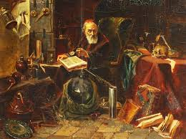
Lesson 1: Tools of the Trade
Lab Equipment and Safety

Slide 4
ChemCatalyst
List at least four tools or pieces of equipment you think a chemist might use in a chemistry lab.
Notes:
Ask: How do you measure the amount of a substance?
Ask: What equipment could you use to combine two substances? To separate two substances?
Ask: How are the tools chemists use like tools you might find in your kitchen or at the grocery store?

Slide 5
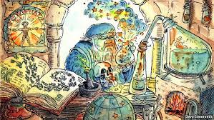
Key Question
What tools and equipment do chemists use?

Slide 6
You will be able to:
recognize common chemistry tools and equipment that you will be using in the course
find all the safety equipment in the laboratory and understand its use
understand the rules of safety in the chemistry laboratory

Slide 7
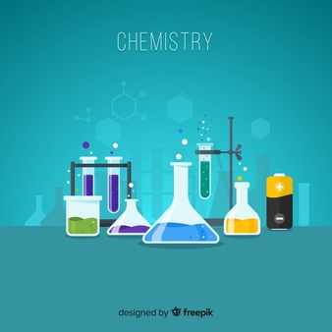
Prepare for the Activity
Work in groups of four.
Notes:
Students will explore their set of lab equipment for 15 minutes then they will present their results to the class for approx. 20 minutes

Slide 8
Discussion Notes
Safety Equipment:
fire blanket | first aid kit
fire extinguisher | aprons/lab coats
eye wash | Shower
safety goggles | hood

Slide 9
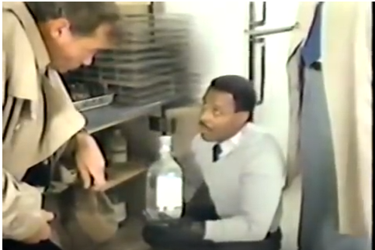
Accident at Jefferson High
https://www.youtube.com/watch?v=S0QnsJV2d3E

Slide 10
Wrap Up
What tools and equipment do chemists use?
Chemists have a set of tools that are useful for studying matter.
Chemistry laboratories have a number of potential hazards.
Chemists know the safety rules and how to use the safety equipment.

Slide 11
Check-In
Sketch or describe these items.
graduated cylinder | test tube rack
Erlenmeyer flask | balance or scale
Where are these items located in your classroom?
eye wash | fire extinguisher

Slide 12
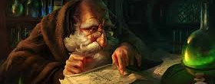
Homework
Read pages 1-5 of your text and complete the Exercises (1-8) on Page 5 in your notebook
There will be a small lab safety and equipment quiz next class!
Notes:
Set up the online book for students to use for homework or copy first 5 pages

