Slide 1
LIVING BY CHEMISTRY
SECOND EDITION
Unit 1: ALCHEMY
Matter, Atomic Structure, and Bonding

Slide 2
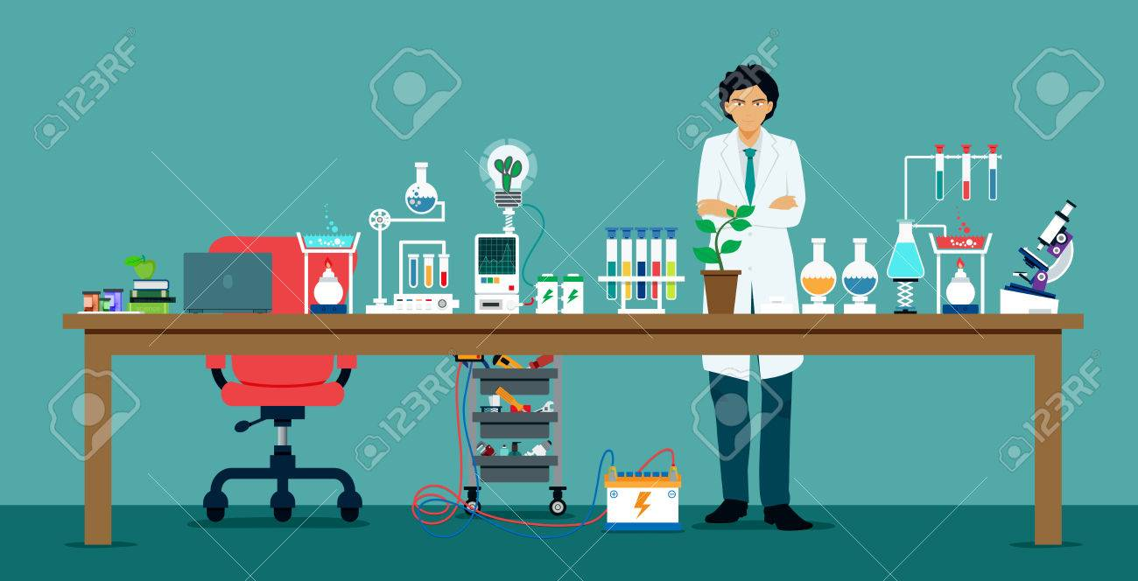
Lesson 4: Mass Communication
Mass and Volume
Day 1

Slide 3
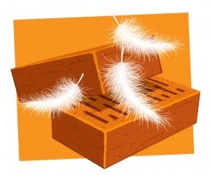
ChemCatalyst
Which has more mass and weighs more, 5 kilograms of bricks or 5 kilograms of feathers? Explain your thinking.
Would it hurt more to be hit with 5 pounds of feathers or 5 pounds of bricks? Explain your thinking.
Notes:
Ask: Is it easier to lift 5 kilograms of bricks or 5 kilograms of feathers? Explain. Ask: What tools would you use to measure mass?
Ask: Which has a greater volume, the bricks or the feathers?
Ask: What tools would you use to measure volume?
Ask: Are large objects always heavier than small objects? Explain.

Slide 4
Key Question
How do you determine the masses and volumes of different substances?

Slide 5
You will be able to:
measure mass using a balance.
measure the volume of regularly and irregularly shaped objects.

Slide 6
Prepare for the Lab (1 of 2)
You will Work in groups of four.

Slide 7
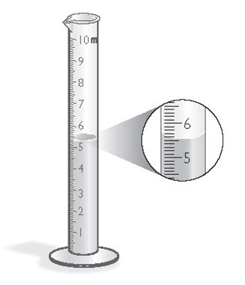
Prepare for the Lab (2 of 2)
In this lab, you will be measuring volume with a graduated cylinder.
To the nearest tenth of a milliliter, the volume of liquid is 5.5 mL.
Notes:
Ask: Does the largest object you measured have the largest mass? Explain.
Ask: What is the difference between mass and volume? Explain.
Ask: Which of the four objects do you think contains the greatest amount of matter?
Ask: Do you think any of the objects are the same type of matter? Explain your thinking.
Ask: How might you use mass and volume to decide whether the “golden” penny is real gold?

Slide 8
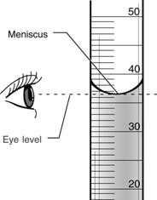

Slide 9
Measuring Volume Practice - Not in the Data Table
Measure the volume of the following objects first before starting the lab:
Marble =
Rubber Stopper =

Slide 10
Question 2 Objects: Measure the Height and Diameter of each object in cm
Object
Large Gold rod: h = d =
Large Silver rod: h = d =
Small silver rod: h = d =
Crayon: h = d =

Slide 11
Discussion Notes (1 of 3)
Mass is commonly measured in units of grams (g) or kilograms (kg).
1 kg = 1000 g
An object has a mass of 15,450 g. What is its mass in kg?
Notes:
Write the word mass on the board. List the units used to measure volume as the students mention them.
Ask: What types of units are used to measure mass? Weight? (grams, kilograms, pounds, tons, etc.)
Ask: If you have 1 pound of cotton and 1 pound of steel, do they weigh the same? Why or why not? (Yes; they have the same mass.)
Ask: If you have 1 gram of copper and 1 gram of gold, do they weigh the same? Why or why not? (Yes; they have the same mass.)
Ask: How do you think mass and weight are different?

Slide 12
Discussion Notes (2 of 3)
Volume is a measure of the amount of space occupied by something.
1000 mL = 1 L
1 mL = 1 cm³
An object has a volume of 55.25 mL how many L?
The volume of a regularly shaped solid is determined using a geometric formula.
For example the volume of a box would be calculated with the formula: l x w x h
Notes:
Ask: What types of units are used to measure volume? (Cups, ﬂuid ounces, liters, pints, cubic yards, etc.)
Ask: Where do you use volume in your everyday life? (Gallons of milk or gasoline, measuring cups for baking, etc.)
Ask: How would you measure the volume of a solid using a graduated cylinder and water? Describe your procedure.
Ask: Do heavier objects displace more water than lighter objects when they are submerged in water? Explain. (No; as long as they are submerged completely, masses of objects do not affect volumes.)
Ask: How would you measure the volume of a shoebox? Of sand?

Slide 13
Discussion Notes (3 of 3)
Mass: A measure of the quantity of matter in an object.
Volume: The amount of space a sample of matter occupies.
Notes:
Ask: What types of units are used to measure volume? (Cups, ﬂuid ounces, liters, pints, cubic yards, etc.)
Ask: Where do you use volume in your everyday life? (Gallons of milk or gasoline, measuring cups for baking, etc.)
Ask: How would you measure the volume of a solid using a graduated cylinder and water? Describe your procedure.
Ask: Do heavier objects displace more water than lighter objects when they are submerged in water? Explain. (No; as long as they are submerged completely, masses of objects do not affect volumes.)
Ask: How would you measure the volume of a shoebox? Of sand?

Slide 14
Wrap Up
How do you determine the masses and volumes of substances?
Mass is a measure of the amount of substance. Mass can be measured using an electronic or triple beam balance.
Volume is the amount of space occupied by an object. The volume of a liquid can be measured in a graduated cylinder.
Objects with similar volumes can have different masses, and vice versa.

Slide 15
Check-In
A penny has a mass of 2.498 g.
What is the mass to the nearest tenth of a gram?
How would you determine the volume of a penny?
What is the difference between mass and volume?
Suppose you find that the golden penny has a mass of 2.6 g. If you compare it with the mass of this penny, what can you conclude?
Notes:
Answers: a) 2.5 g. b) By measuring its dimensions and using a geometric formula or by immersing it in water and measuring the change in the volume of the water. c) Mass is the amount of matter or “stuff.” Volume is the amount of space the matter or “stuff” takes up. d) The golden penny has more mass.

Slide 16
Volume Practice Problems
Volume formulas:
Block → V = l x w x h
Cylinder → V = πr²h
Sphere → V = 4πr³/3
Calculate the volume of the block on your desk, one of the metal cylinders, and a marble (diameter of 2.5 cm

Slide 17
Lesson 4 Classwork/homework
Read Lesson 4 pages 13-16 carefully
Page 16 Answer questions 1-11 neatly, in full sentences

Slide 18
Day 2

Slide 19
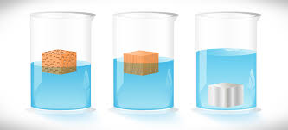
Lesson 5: All That Glitters
Density

Slide 20
ChemCatalyst
In the year 250 B.C.E., King Hiero commissioned a goldsmith to make him a crown out of pure gold. However, when he received the crown, he suspected that the goldsmith had taken some of the gold and replaced it with a cheaper metal, even though it still weighed the same. He asked Archimedes to determine whether the crown was solid gold.
How do you think Archimedes determined whether the crown was solid gold?
Notes:
Ask: How can you tell whether something is gold? (Color, hardness, shininess, etc.; compare it to a pure gold sample.)
Ask: Do you think a crown of gold and a crown of aluminum of identical size have the same volume? Would they have the same mass? Ask: According to legend, Archimedes submerged the crown in water. What was Archimedes measuring? (Volume.)
Ask: Could Archimedes determine the identity of the crown’s metal only by putting it in water? Explain

Slide 21
Key Question
How can you use mass and volume to determine the identity of a substance?

Slide 22
You will be able to:
define density as the amount of mass in a certain space, or mass per unit volume.
solve problems for density, mass, or volume using the equation D = m/V.
explain how and why density can be used to identify a substance.

Slide 23
Prepare for the Lab
Work in pairs.

Slide 24
Discussion Notes (1 of 2)
Extensive property: A characteristic that is specific to the amount of matter.
Intensive property: A characteristic that does not depend on the size or the amount of matter.
Density: The mass of a substance per unit volume.
D = m/V, where D is density, m is mass, and V is volume. Density is usually reported in g/cm³ or g/mL.

Slide 25
Discussion Notes (2 of 2)
Common materials and their densities.
Material | Density | Material | Density
zinc | 7.1 g/cm³ | gold | 19.3 g/cm³
paper | 0.9 g/cm³ | brass | 8.4 g/cm³
water | 1.0 g/mL | copper | 9.0 g/cm³
aluminum | 2.7 g/cm³ | lead | 11.4 g/cm³
Notes:
Ask: Recall the ChemCatalyst question. Was it possible for Archimedes to determine the density of the crown? Why or why not? (Yes; he measured both mass and volume.)
Ask: How could you use density to determine if a crown is solid gold? (Compare its density to the density of pure gold—at least this way you would know if it is not gold.)
Ask: What does the evidence tell us about the gold-colored penny? (It is not pure gold.)
Ask: Do you have a hypothesis about what happened to the penny in Lesson 2: A Penny for Your Thoughts?

Slide 26
Wrap Up
How can you use mass and volume to determine the identity of a substance?
One substance can be distinguished from another by examining its intensive physical properties, such as density.
Density is a measure of the mass per unit volume of a substance.
The density of any given substance is always the same (as long as the temperature remains constant).

Slide 27
Check-in
In 1999, the United States Mint produced a coin called the Golden Dollar. It features an image of Sacagawea, the famous Native American guide for Lewis and Clark. It has a mass of 9.8 g and volume of 1.1 mL.
Is this coin truly gold? Explain. (The density of gold is 19.3 g/mL.)
Notes:
Answer: The density of the Golden Dollar is 9.8 g/1.1 mL or 8.9 g/mL. This is much less than the density of gold, so the
Golden Dollar is not solid gold.

Slide 28
Lesson 5 Classwork/Homework
Density practice worksheet – show all work (Odds only) – Honors Chemistry
Read Lesson 5 in the textbook pages 16-20 & do Exercises 1-7 – all
Next class will be a quiz on lessons 1-5
Chapter 1 Summary & Review Exercise are on Page 21

Slide 29
Kahoot Review Game
You may use your phone or one of the classroom computers.
Use your own name or initials and everyone must play (I CHECK!)

Slide 30
Lesson 5 Classwork/Homework
Density practice worksheet – show all work (Odds only) – Honors Chemistry
Read Lesson 5 in the textbook pages 16-20 & do Exercises 1-7 – CP1
Next class will be a quiz on lessons 1-5
Chapter 1 Summary & Review Exercise are on Page 21

Slide 31
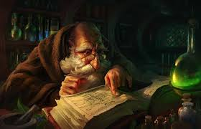
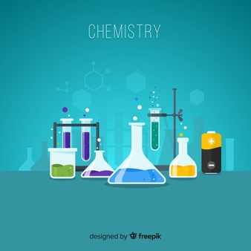
Friday September 13th, 2019
Kahoot Review
Unit 1 Chapter 1 Quiz “Defining Matter” – need a calculator
Video “Chemistry a Volatile History” Part 1 – answer questions as you watch
No Homework

